Slide 1


Slide 3

30 $+$ 12 $=$ 15 $+$ 6 $=$ 45 $+$ 18 $=$
5 $×$ 9 $=$ 2 $×$ 9 $=$
5 $×$ 6 $=$ 2 $×$ 6 $=$
35 $+$ $=$ 42
Double 21

Slide 4
30 $+$ 12 $=$ 15 $+$ 6 $=$ 45 $+$ 18 $=$
5 $×$ 9 $=$ 2 $×$ 9 $=$
5 $×$ 6 $=$ 2 $×$ 6 $=$
35 $+$ $=$ 42
Double 21
42
21
63
45
18
30
12
7
42

Slide 6
Complete the sentences.
4
There are ____ heptagons.
Each heptagon has ____ sides.
There are ____ sides altogether.
7
28

Slide 7


Complete the missing numbers.
4
There are ____heptagons.
Each heptagon has ____ sides.
There are ____ sides altogether.
7
28
7
28
$+ + + =$
7
7
7
$× =$
4
7
28
$× =$
7
4
28

Slide 8
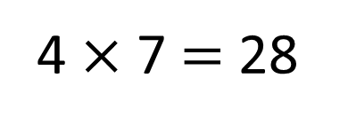
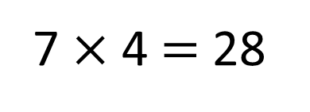
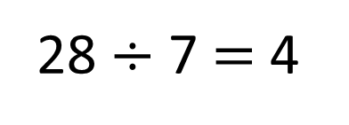
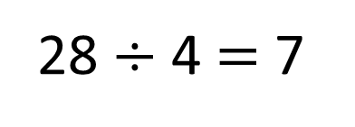
7 $×$ 4 $=$ 28
4 $×$ 7 $=$ 28
28 $÷$ 4 $=$ 7
28 $÷$ 7 $=$ 4

Slide 9
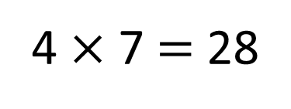
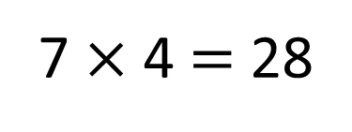
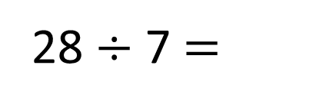
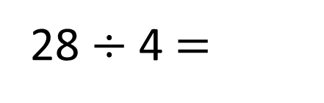
28
7
7
7
7
7 $×$ 4 $=$ 28
7
28 $÷$ 4 $=$
4 $×$ 7 $=$ 28
4
28 $÷$ 7 $=$

Slide 10
Have a go at questions
1 – 5 on the worksheet

Slide 11


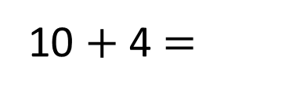
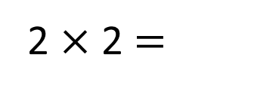
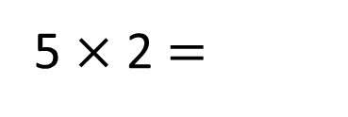
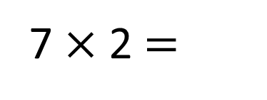
I don’t know my 7 times-table yet, I’ve only learnt up to my 5 times-table
4
10
14
So I can add 5 lots and 2 lots together
Don’t worry, you can use those to help you. Watch…
7 $×$ 2 $=$
14
5 $×$ 2 $=$
10
2 $×$ 2 $=$
4
10 $+$ 4 $=$
14

Slide 12
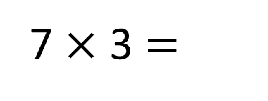
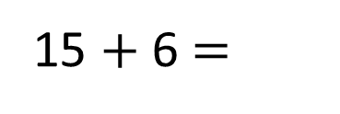
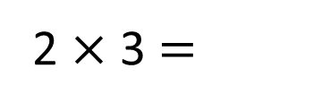
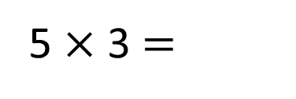
So I can add 5 lots and 2 lots together
Don’t worry, you can use those to help you. Watch…
7 $×$ 3 $=$
7 $×$ 2 $=$
14
21
5 $×$ 2 $=$
5 $×$ 3 $=$
10
15
2 $×$ 2 $=$
2 $×$ 3 $=$
4
6
10 $+$ 4 $=$
15 $+$ 6 $=$
14
21

Slide 13

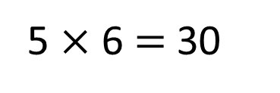
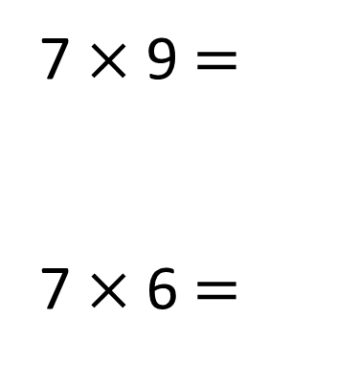
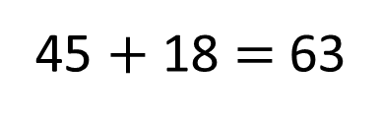
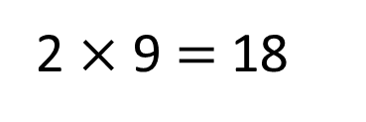

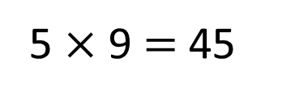
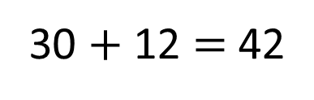
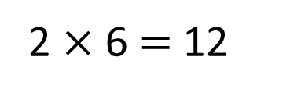
You could also subtract 7 from 70 like when we looked at the 9 times-table
You could also have done
5 $×$ 7 plus 1 $×$ 7
So I can add 5 lots and 2 lots together
Have a think
7 $×$ 9 $=$
7 $×$ 6 $=$
63
5 $×$ 9 $=$ 45
45 $+$ 18 $=$ 63
2 $×$ 9 $=$ 18
42
5 $×$ 6 $=$ 30
30 $+$ 12 $=$ 42
2 $×$ 6 $=$ 12

Slide 14

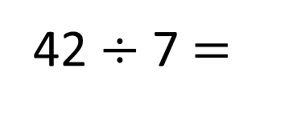

42 $÷$ 7 $=$
6
Have a think
I know that 35 $÷$ 7 is 5
7
5
35
6
42

Slide 15


42 $÷$ 7 $=$
6
Have a think
I know that 35 $÷$ 7 is 5
I know that 21 $÷$ 3 is 7
7
3
21
6
42
3
21

Slide 16
Have a go at the rest of the worksheet

