Slide 1
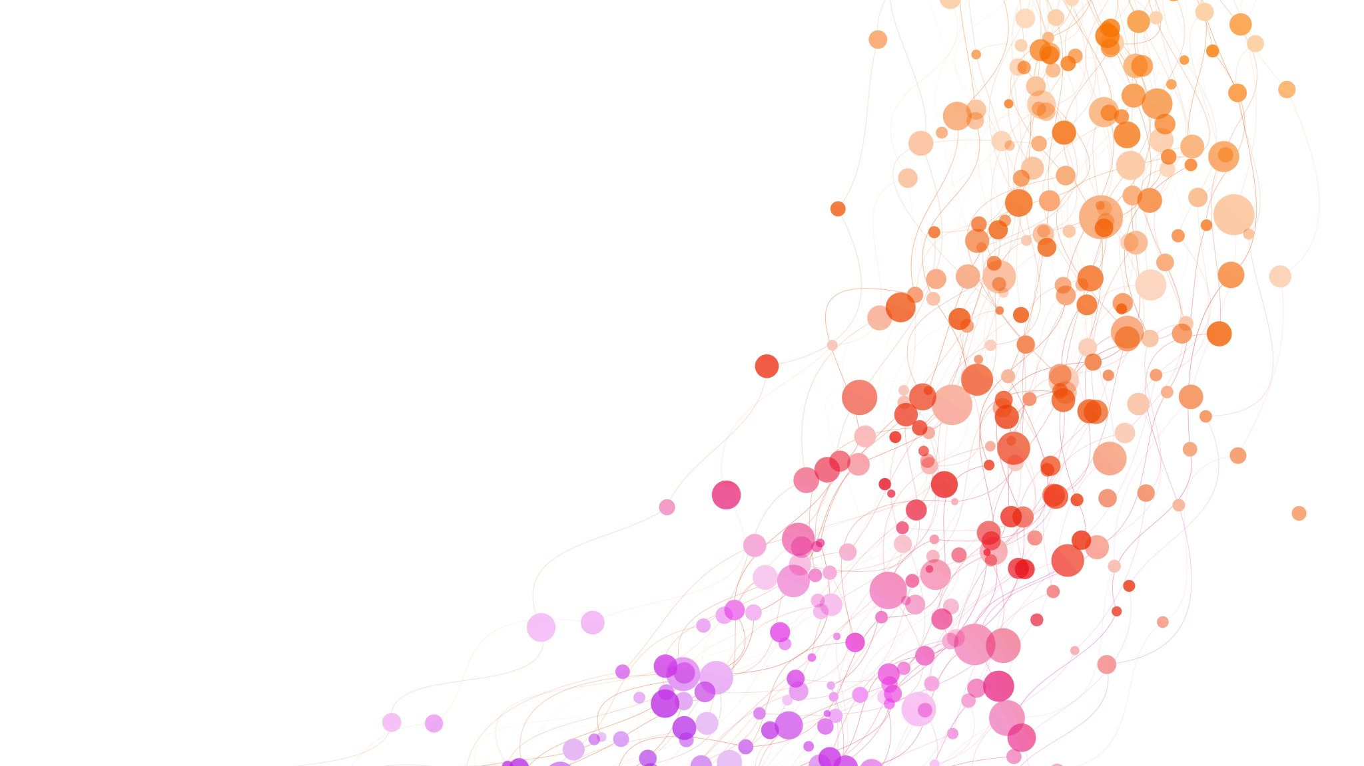
Year 1 'Screen free' day
Aim: To support children's mental wellbeing and provide children with non screen challenges to enjoy on their own and with family.
Rules: The only rules are that you have fun and stay safe. If you get something out, please help your adults by putting it away .
Friday 12th February 2021

Slide 2
Some of these fun activities you could do with your family ; some are for you on your own ! Either way, enjoy the day and let us know how you get on! All equipment needed is what is in your home. Try not to look on the internet for help! Give it your best go and enjoy using your Yatton Creativity skills!
Go on a walk around the village. Take a camera or phone with a camera. Look for signs which include the letters in your name. Print out each letter to make your name – you might find some on road signs, car badges or shop names.
Go outside and drop an egg from a 1cm height. How high can you drop it from before it smashes? Don't forget to take a ruler! You could pad out a soft landing for your egg with kitchen roll or an old cloth.
Play 12s with your family. Start counting at 1 and go round saying one, two or three numbers at a time. The person who says 12 is out!

Slide 3
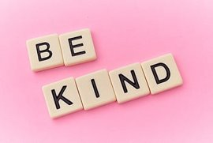
Wiggle a biscuit from your forehead into your mouth in the quickest time.
Make a food 'pet' or 'face'. You might choose a goldfish,a dog or a cat. Use dried foods (check first!) to make your 'pet'. Kidney beans and dried spaghetti are always good for this !
Build the most impressive bridge that you can from items in your home. What will you use to test its sturdiness ?
Disguise a fruit as another fruit! How could you make an apple look like a pear?
Transfer water between two bowls without moving either of the bowls
Use Scrabble letters to make up questions or challenges for someone in your family.

Slide 4
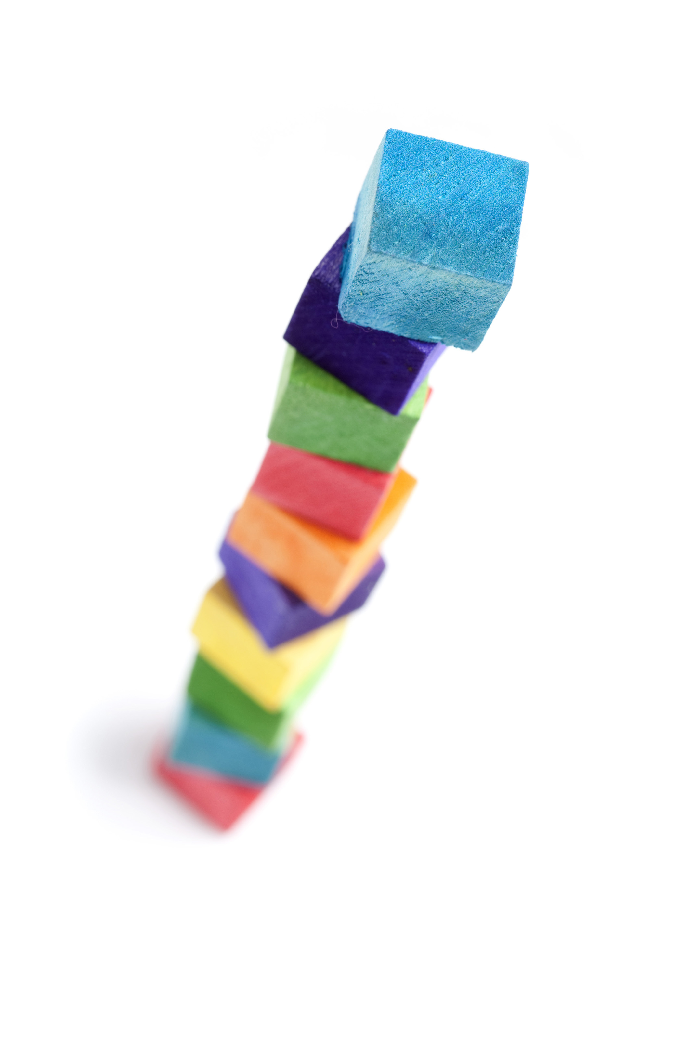
Paint with flowers. Pick some flowers from your garden and dip them in paint to produce a stunning painting without paintbrushes! You could add petals with fingerprints!
Make the tallest freestanding tower from items in your home.
Draw a self portrait ( a picture of yourself) using only ketchup, salt and pepper! Don't forget to use a plate!
Change the colour of a glass of milk !
Using only one slice of bread, make yourself the best eyebrows, moustache and beard that you can think of!
Design a magnificent ice cream sundae

Slide 5
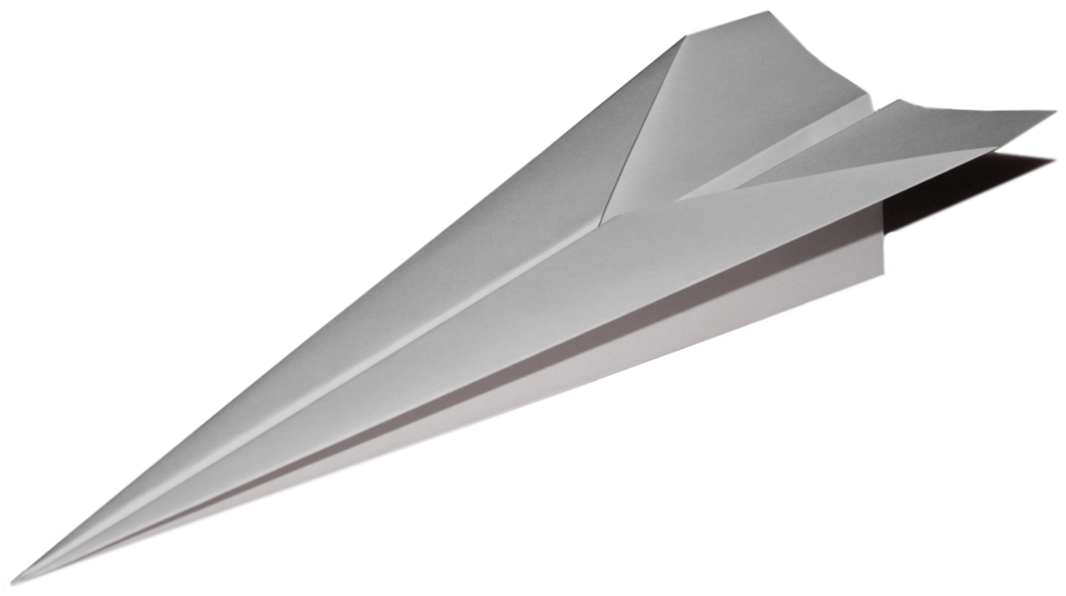
Make or draw a rainbow without using paint, pens or pencils.
Make someone in your family breakfast or lunch as a surprise. Don't forget to clear up!
Make a den that can fit at least 3 people in.
Paint a picture whilst blindfolded! You might want to do this one outside!
Learn a poem from a book you have off by heart
Make and decorate the best paper aeroplane. How far will it fly ?
Score a goal with a pair of socks and a carrier bag! How creative can you be ?
How many socks can you pair in one minute? You could take them from the clean washing pile to help your parents out!

Slide 6
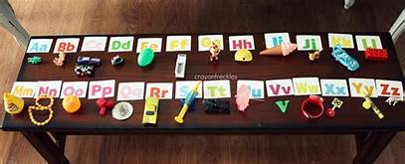
Make and send a card / picture to someone – a relative or friend. It will make them feel special !
Listen to your favourite song (try not to look at the screen it is on You Tube! - try Spotify if an adult in your house has it). Learn the words and tap out the rhythm! You could then learn the dance routine to it !
Go outside and look at the clouds – are they moving ? Can you see any shapes in them ? Perhaps you can see a face / a dog / a dinosaur!
Make a healthy smoothie and give it a name!
Make an obstacle course in your garden or in a long room (out of the way!). Challenge your family to complete it – don't forget to clear it up afterwards!
Go on an alphabet hunt around the house. Try to find a small object beginning with each letter of the alphabet.

Slide 7
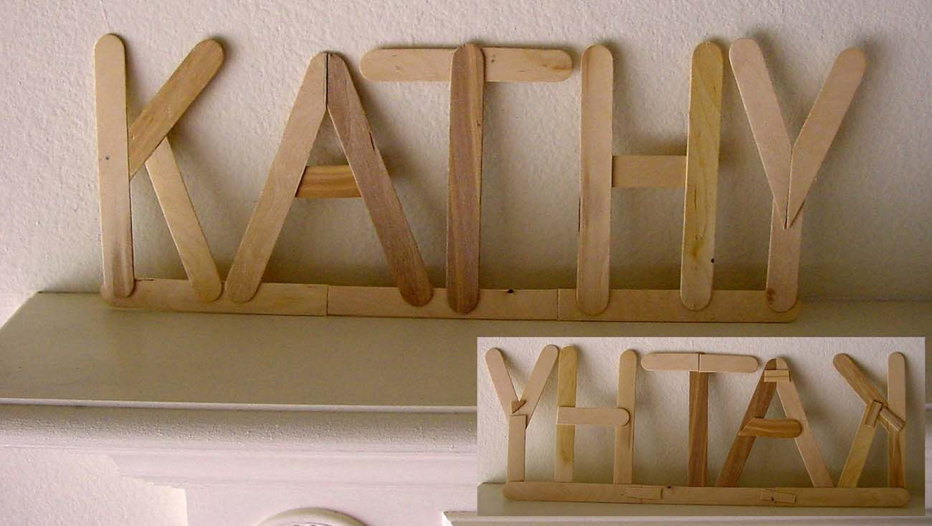
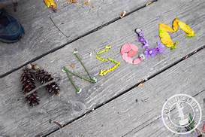
Try a new fruit or vegetable that you think you might not like ! You might surprise yourself !
Perform a random act of kindness. This might be out on a walk. You could leave a wrapped chocolate bar on a post for someone else to find. Don't forget to add a note saying 'This is a random act of kindness' so that they know it is OK to take it !
Make a collage of your favourite people using photos.
Make your name out of sticks or flowers.
Most of all – have fun , stay safe and stay off your screens! Have a wonderful half term break.
.

