Slide 2
Getting started
Please click on the video link below first.
Watch the video and read the information on the Ancient Egyptian Hierachy.
https://www.historyforkids.net/egyptian-hierarchy.html

Slide 3
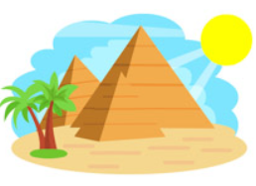
So, the Egyptian hierarchy was a lot like the pyramids that they built.
Your activity today is to place all the different jobs people may have had in Ancient Egypt on a pyramid with the least important people at the bottom and the most important at the top.

Slide 4
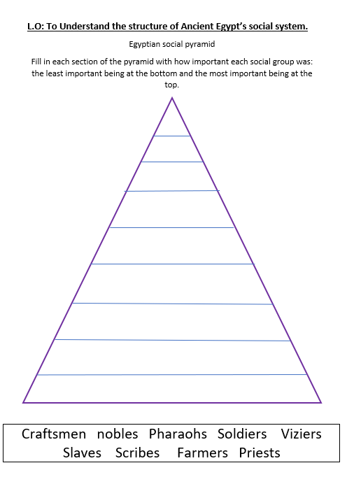
You will need:
Your worksheet
The labels cut out
A pencil (or glue to stick the labels on)

Slide 5
Read through the following descriptions and put them in the order you think they go in.
It may help to write the jobs out on 9 pieces of paper and cut them out to sort
Craftsmen Nobles Pharaohs Soldiers Viziers Slaves Scribes Farmers Priests

Slide 6
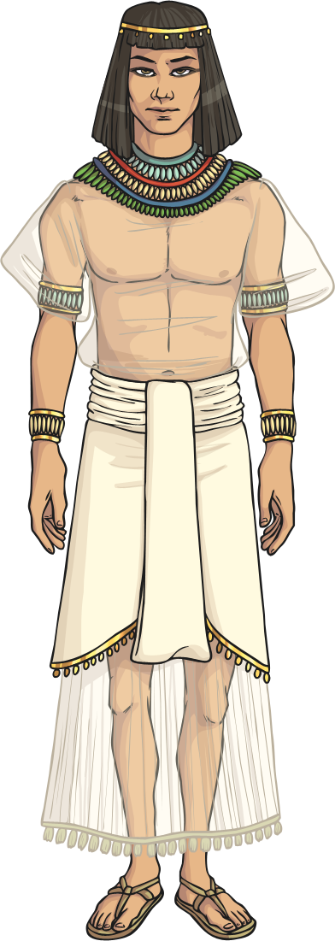
Viziers
Viziers were the second most powerful people of Egypt. They helped the pharaohs rule and were high judges in court. They were the people to talk to if you needed to speak with the pharaoh.

Slide 7
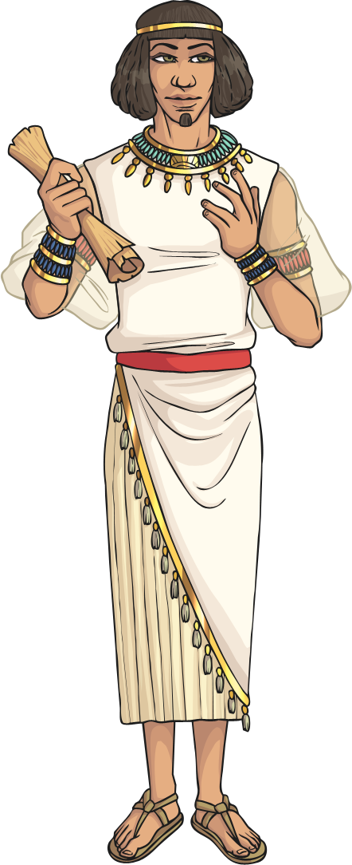
Nobles
Under the Viziers were the Nobles. The nobles ran the provinces of Egypt and made the local laws. This job was passed down through families. Nobles became wealthy because they kept some of the taxes paid to the Pharaoh.

Slide 8
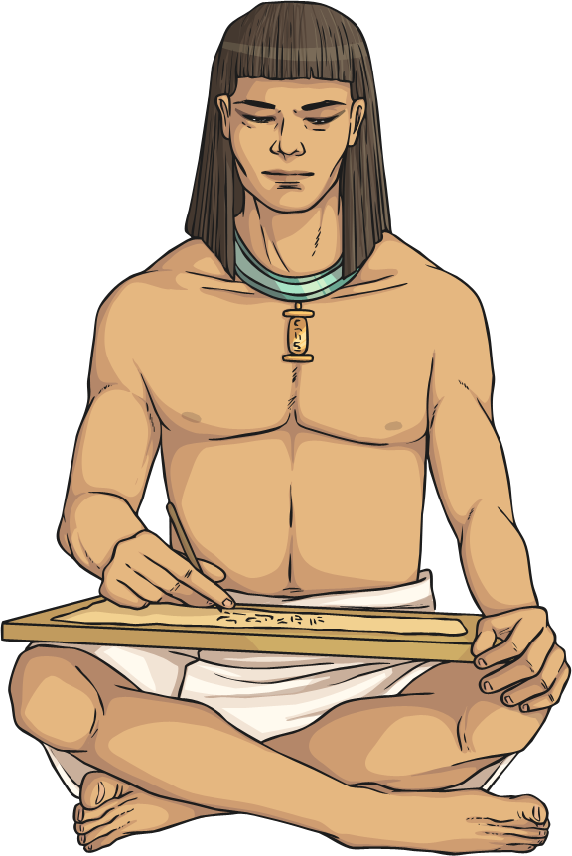
Scribes
The second most important members of the middle class were the scribes. Scribes were the only people who could read and write. They recorded the events of Egypt using hieroglyphics.

Slide 9
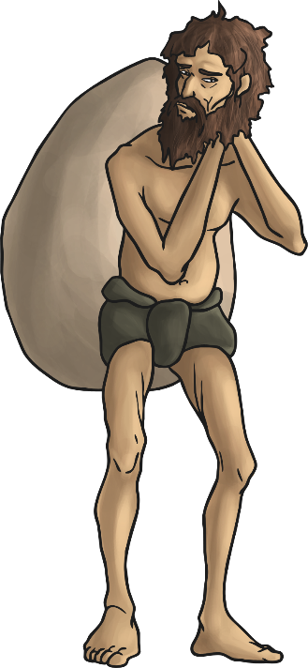
Slaves
Slaves were the lowest people in Egyptian society. They were usually not Egyptian as they were captured during wars. They had no rights or property of their own. They worked for rich families and the pharaoh. They would be killed if their master died, so that they could look after them in the afterlife.

Slide 10
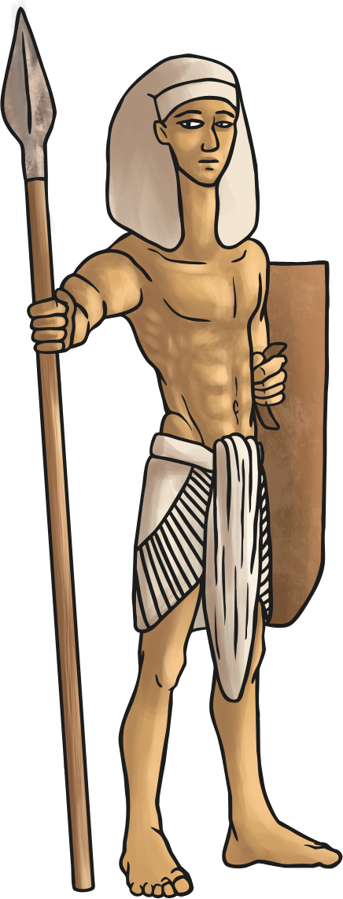
Soldiers
Soldiers were seen as heroes for protecting the country and were rewarded with land and riches. They were the most important members of the Ancient Egyptian middle class

Slide 11
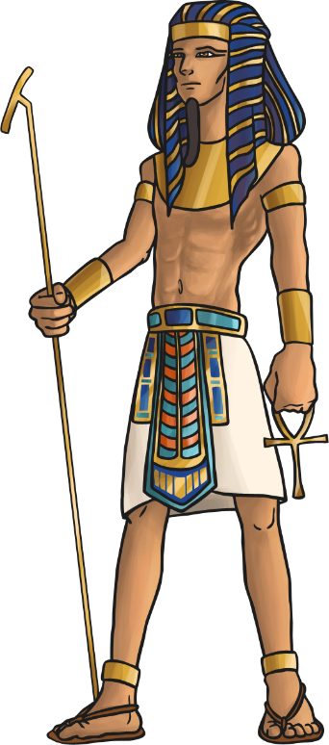
Pharaohs
At the very top of the social structure were the Pharaohs
Pharaohs were the kings or queens of Egypt.
The most rich and powerful who decided everything about the country. They were almost seen as gods!

Slide 12
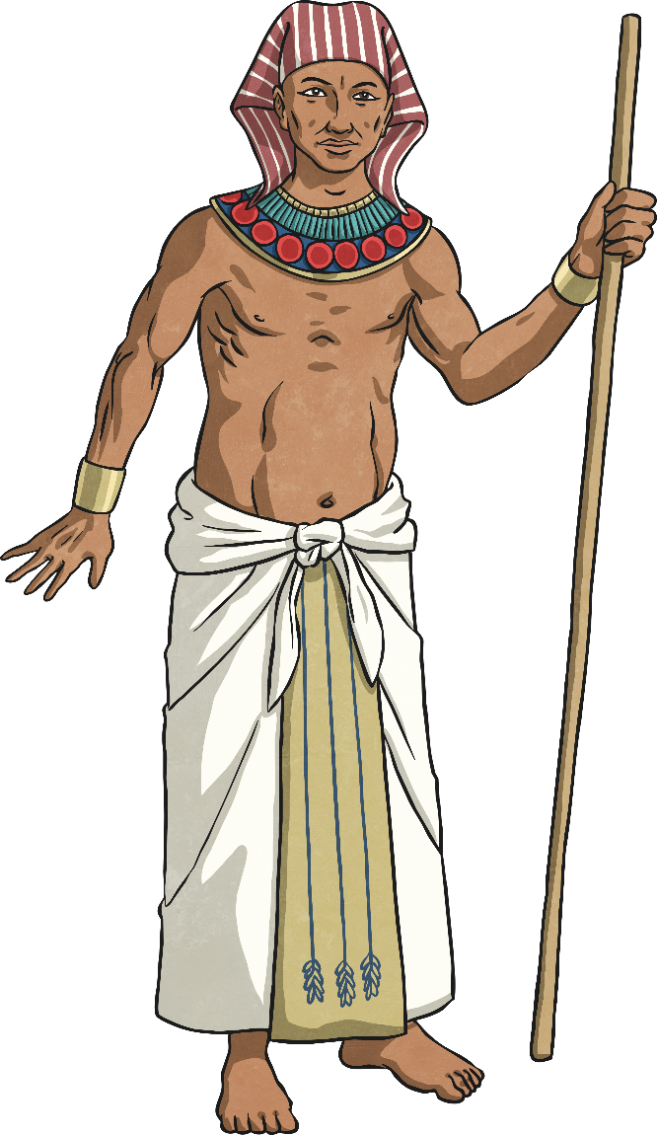
Craftsmen
The final member of the middle class was the craftsmen. Craftsmen were skilled people who made things like pottery, cloth, jewellery, shoes, leather and statues.

Slide 13
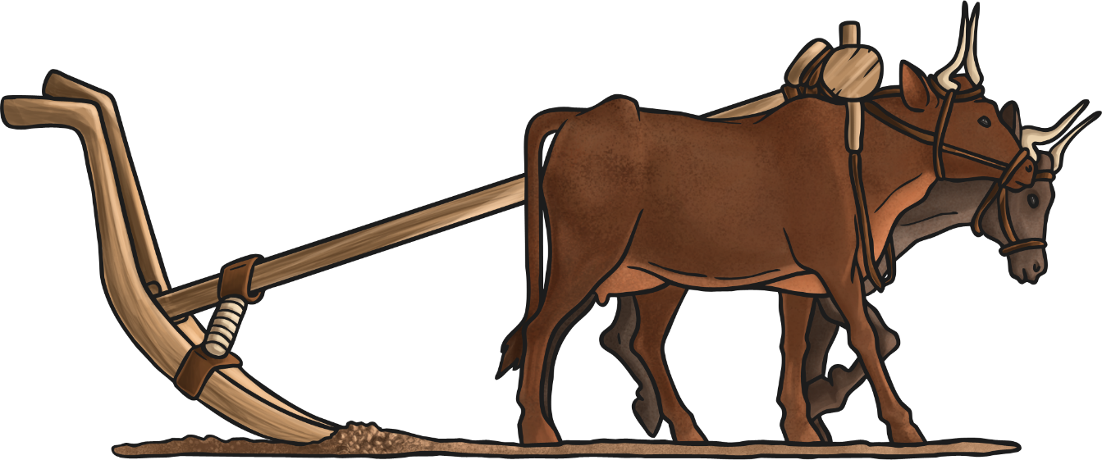
Farmers
At the bottom of the social structure were farmers. Only slaves were lower than them. Farmers worked on the lands that belonged to the pharaoh. They were paid with food, clothes and a home. They paid their rent with the money they made from selling crops. Most ordinary Egyptians were farmers.

Slide 14
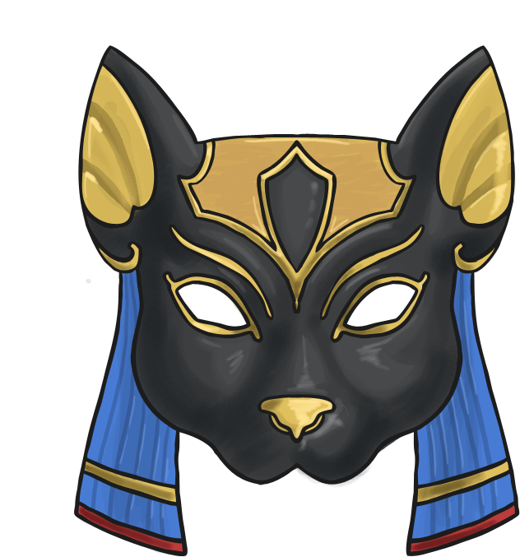
Priests
Nearly as important as the nobles were the Priests. Priests kept the gods happy. They worked in temples and carried out ceremonies and rituals for people.

Slide 15
The end
Adapted from a PowerPoint on Twinkl

