Slide 1
Session 2 Aims for today: To learn about the mezuzah and its significance to Jewish households. To understand that investigating the Shema is a way of understanding core Jewish beliefs. To know how Judaism started and that the Torah is the Jewish Holy Book
Key Question: ‘What does it mean to belong to the Jewish religion?’

Slide 2
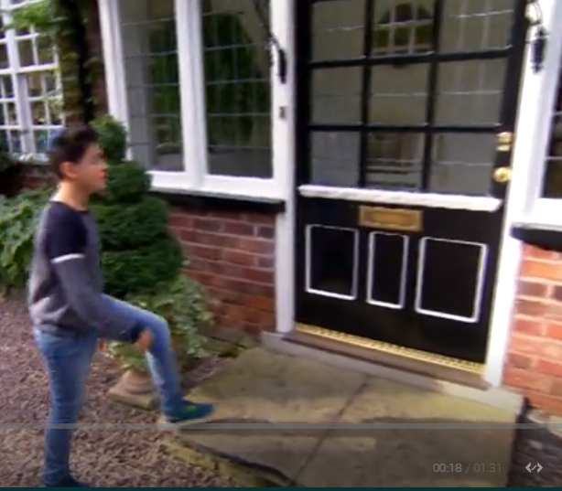
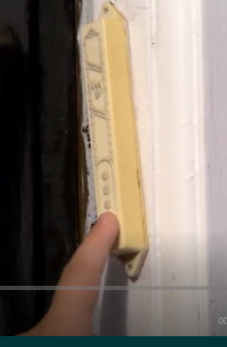
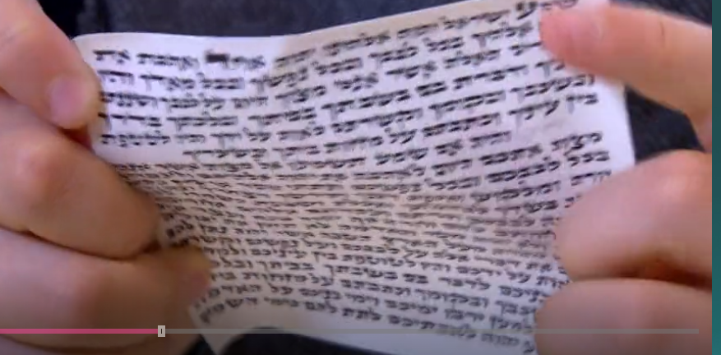
Do you remember when we watched the clip about Charlie and what it meant to be Jewish? He showed how Jewish houses have mezuzahs on their door frames. Watch the clip again if you wish.
https://www.bbc.co.uk/programmes/p02mx8pg

Slide 3
What is a Mezuzah?
The Mezuzah is a scroll which Jewish people keep inside a case.

Slide 4
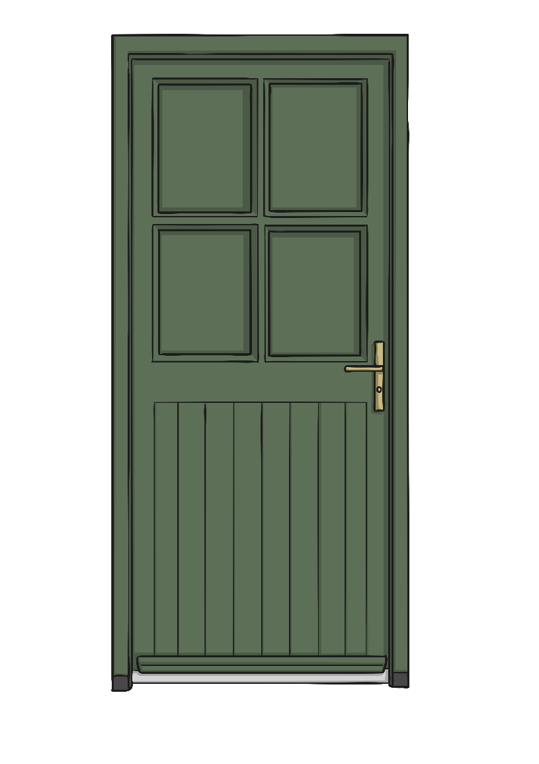
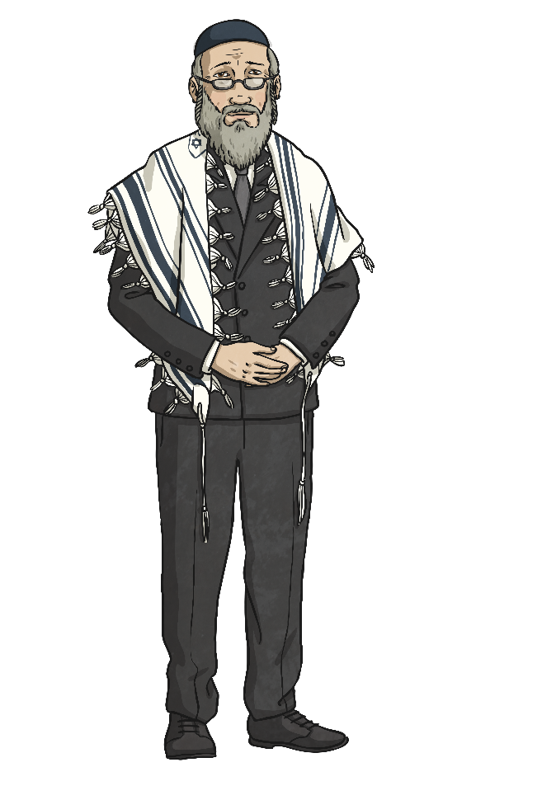
Where does a Mezuzah belong?
The Mezuzah is fixed to the right side of their doorframe and when Jewish people fix it there they chant ‘Blessed are you, Lord, our God, Sovereign of the Universe’.

Slide 5
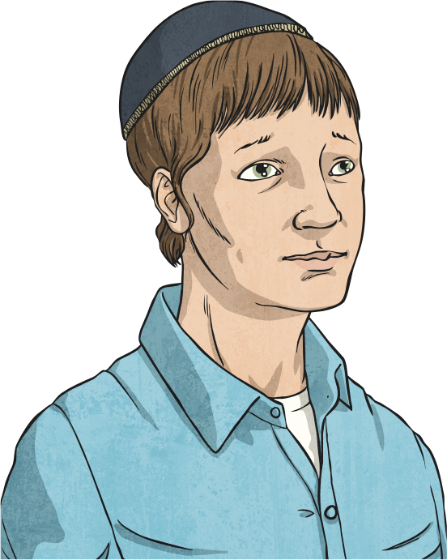
Why is the Mezuzah important?
The Mezuzah is placed on doorframes to constantly remind Jewish people of God’s presence.

Slide 6
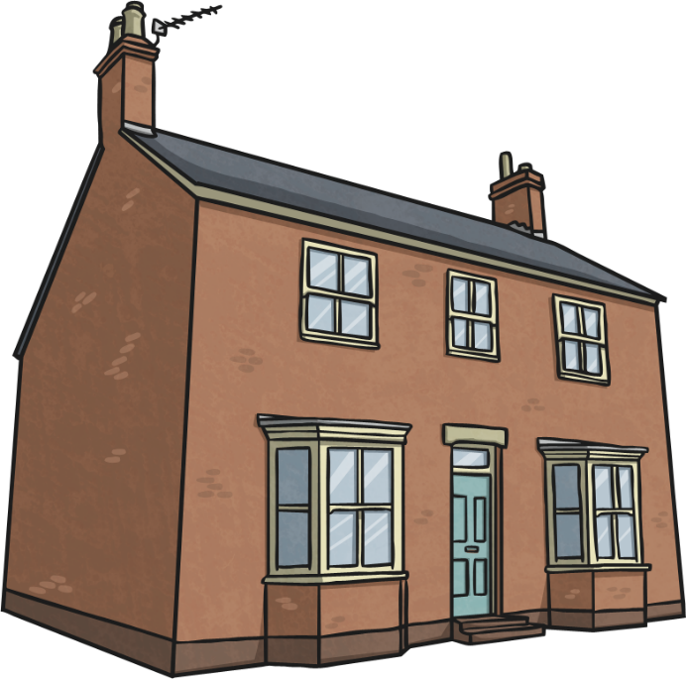
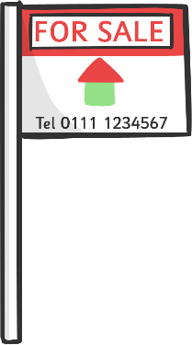
What happens if you move house?
If Jews move house they have to take the Mezuzah down from the door and take it with them.

Slide 7
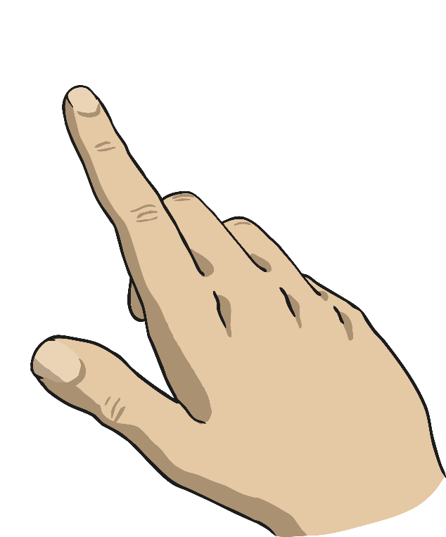
What do you do with a Mezuzah?
Whenever a Jewish person goes through their door they touch the Mezuzah to remind themselves that God is there.

Slide 8
So what is inside a mezuzah?
The scroll contains the first two paragraphs of the "Shema" prayer

Slide 10
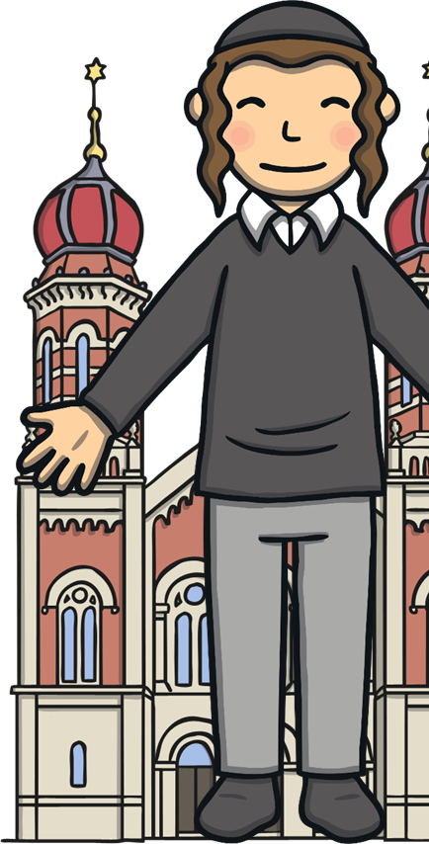
What is the Shema?
Shema is one of the most important Jewish prayers.
It is one of the first prayers learnt by Jewish children.
It is said three times every day by Jewish people.
It is included in nearly every service at the Synagogue.

Slide 11
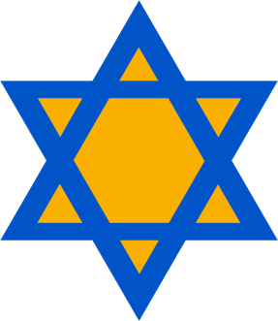
Why is the Shema Important?
The Shema prayer is important for lots of reasons.
It reminds Jewish people that:
God loves everybody and they should love Him.
Everybody should follow God’s rules.
Children should be taught the Torah.
There is only one God.
Click on the Stars of David to reveal!

Slide 12
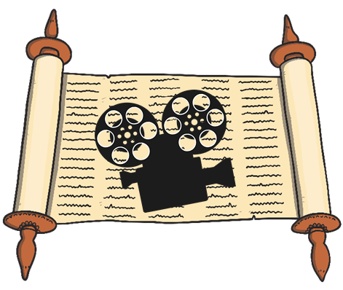
Where Can the Prayer Be Found?
The Shema can be found inside the Torah.
Click on the camera to watch the film clip.
Can you answer these questions?
What is the boy reciting at the beginning of the video?
How often is the prayer read?
What is the boy wearing to show respect to God?
Notes:
Please watch the first two minutes only.
Please check the content of this link, including any comments or potential advertisements, is suitable for your educational environment before showing. Please do not let the next video automatically play at the end of the clip. Twinkl accepts no responsibility for the content of third party websites.

Slide 13
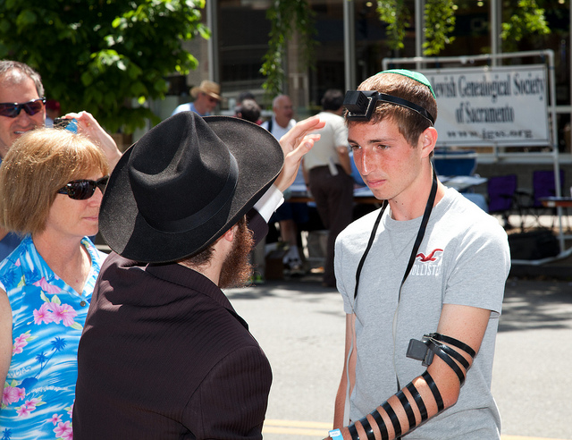
Where Else is the Shema Found?
The Shema can be found inside the Tefillin.
The Tefillin are strapped to the left arm and forehead.
It is a constant reminder that God is in their mind and their heart.
The Shema can be found inside a Mezuzah.
There is one on each door frame.
When Jewish people pass the Mezuzah they kiss it.
Photo courtesy of Robert Couse-Baker, Loren Javier(@flickr.com) - granted under creative commons licence – attribution

Slide 14
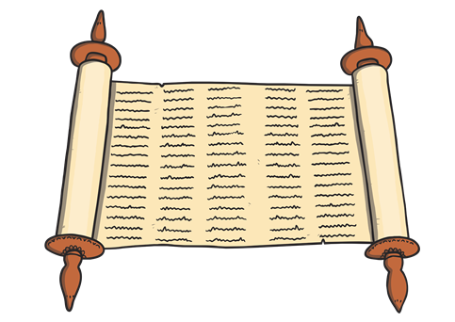
What Does the Prayer Mean?
The prayer is written in Hebrew.
The word Shema means to hear or listen.
The prayer has three paragraphs.
Here is a translation of the first paragraph:
Hear O Israel, the Lord is our God, the Lord is One.
Blessed is His name, whose glorious kingdom is forever and ever.
Love the Lord your God with all your heart, and all your soul, and all your might. These words that I command you today shall be upon your heart. Repeat them to your children, and talk about them when you sit in your home, and when you walk in the street; when you lie down, and when you rise up. Hold fast to them as a sign upon your hand, and let them be as reminders before your eyes. Write them on the doorposts of your home and at your gates.
Deuteronomy 6: 4-9

Slide 15
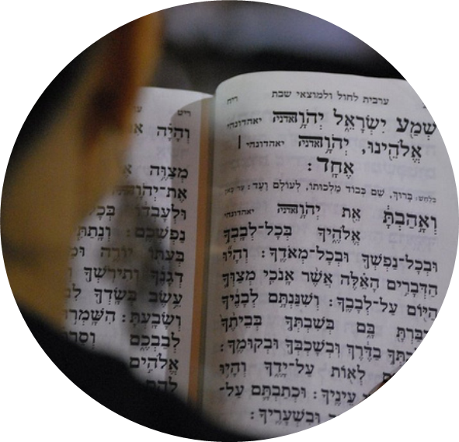
What Can You Remember About the Shema?
Can you repeat two things you can remember about the Shema?
Photo courtesy of Shlomit Or(@flickr.com) - granted under creative commons licence – attribution

Slide 16
Glossary
Jewish A Jewish person belongs to the faith of Judaism.
prayer A request or expression of thanks towards God.
synagogue The Jewish place of worship.
Torah A holy book on a scroll.
Tefillin Two small leather boxes.
Mezuzah A case attached to a door post.
Hebrew The language spoken or read by Jewish people.

Slide 17
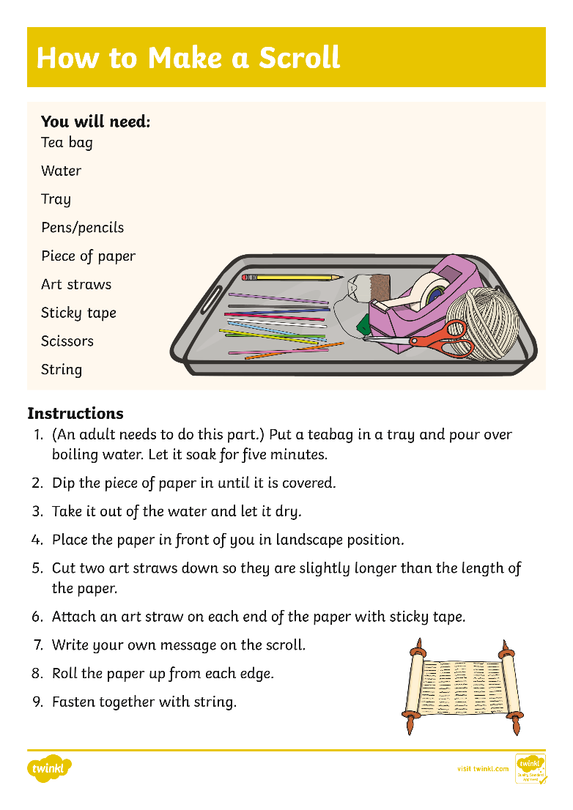
Activity: To make your own scroll to make a prayer to go in a mezuzah or your own Torah.
Note: you can make an ‘art straw’ by rolling up an A4 piece of paper lengthwise as tightly as you can and then glue or tape it down. You could use thin sticks instead.
Write the important messages of the Shema on your scroll important parts of the Shema on your scroll
There is only one God
God loves everybody and they should love Him.
Everybody should follow God’s rules.
Children should be taught the Torah
Challenge 1: Make a scroll Challenge 2: Make a scroll and choose one important message from the Shema to write on it Challenge 3: Make a scroll and write 2 or more important messages from the Shema.

Slide 18
Can You Make Your Own Torah?
Notes:
Please watch the first two minutes only.
Please check the content of this link, including any comments or potential advertisements, is suitable for your educational environment before showing. Please do not let the next video automatically play at the end of the clip. Twinkl accepts no responsibility for the content of third party websites.

