Slide 1
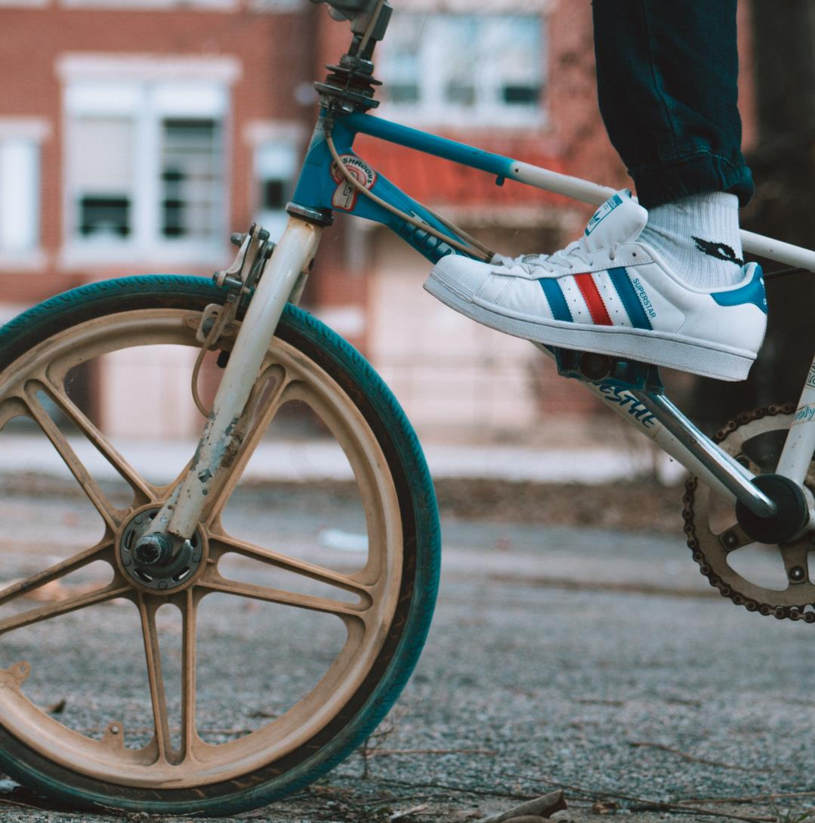
Offline Friday
We are going to take a break from technology today and all the learning will be offline. So, check out the challenges on the next page and choose the ones that most appeal to you!

Slide 2
Choose your challenges!
Click on the Choose your challenges below for the activities.
So, make sure you have fun and please send us any videos or pictures that you create!

