Slide 1
Week 4

Slide 2
L.O. to add description to a piece of writing.
Listen to the reading of Chapter 18, 19 and 20.
Ted mentions Sherlock Holmes, who is he?
What do you know about him?
He is the world’s most famous fictional detective.
Ted and Kat act like detectives in The London Eye Mystery, trying to solve the mysterious disappearance of Salim.
Monday -Session 1

Slide 3
L.O. to add description to a piece of writing.
We are going to read an exciting part of a mystery story that has been written completely in dialogue. It would sound better with only a little dialogue and more description. So, you are going to rewrite it with less dialogue and more description.
Remember to include some short, sharp sentences to build the tension. Plus, fronted adverbials and subordinating conjunctions (AWHITEBUS) for complex sentences, this will make your writing more effective.
Monday -Session 1

Slide 4
L.O. to add description to a piece of writing.
Wake up Tom, quickly, I can hear something!’
claimed Peter.
‘What ... what?’ Tom mumbled.
‘I think something is coming closer,’ Peter cried.
‘Shhh, I think I can hear it too,’ Tom replied.
‘What do think it is? I’m so scared,’ Peter wailed.
‘Me too, look there’s a shadow on the tent.’ Tom
squealed.
‘Oh no, it looks like they are holding a huge
hammer,’ Peter garbled.
‘I’m going to get under my sleeping bag!’
‘Me too!’
Monday -Session 1

Slide 5
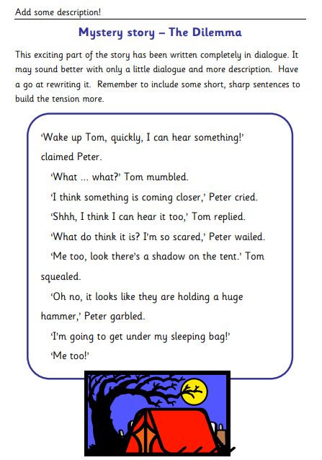
L.O. to add description to a piece of writing.
Monday -Session 1

Slide 6
L.O. to predict what you think might happen next in a text.
Read Chapter 21 and up to page 176 of Chapter 22
The white lettering on the shirt is…
ONTLI
ECUR
What could the words be? The beginnings and ends of each of the two words were cut off by the jacket.
Tuesday -Session 2

Slide 7
L.O. to predict what you think might happen next in a text.
Read to the end of Chapter 23
What might Ted do next?
Is he brave enough to find the man on his own if it involves lying?
Tuesday -Session 2

Slide 8
L.O. to predict what you think might happen next in a text.
Predict what you think Ted will do next, support your ideas with events from the text.
Tuesday -Session 2

Slide 9
L.O. to write a character study.
Read chapter 24 & 25
Discuss Ted’s questions…
Was this the right thing to do?
What if mum found the note and didn’t believe it?
What if I didn’t find Kat in Earl’s Court Exhibition Centre?
What if I didn’t find Earl’s Court at all?
What if I didn’t even make it to our local underground station?
Wednesday -Session 3

Slide 10
Wednesday -Session 3
L.O. to write a character study.
Finish reading until the end of Chapter 27
How has Ted’s character changed from the beginning of the book?
Think about his increased bravery and confidence.
Today, you will be writing a character study of Ted.
What might you include?
General information about Ted e.g. his family
Likes and dislikes
Hopes and fears
His brain working on a different operating system from others

Slide 11
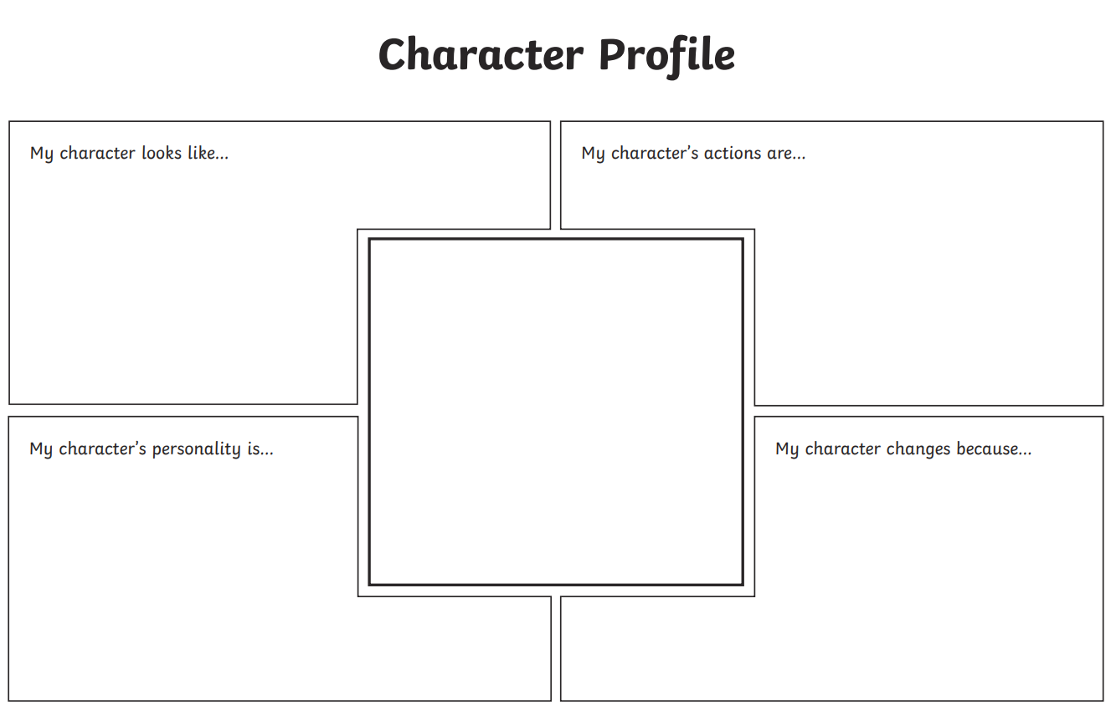
Wednesday -Session 3
L.O. to write a character study.
Challenge 1
Can compete this character profile.
Challenge 2 & 3
May wish to use this template to initially make notes, then lay their writing out in paragraphs using different headings e.g. family, appearance, hobbies, hopes and fears, how Ted has changed.

Slide 12
L.O. to write a haiku and tanka poem explaining events in a text.
Listen to Chapter 28 and 29
Thursday -Session 4
What is a haiku poem?
A haiku is a form of poem that originates from Japan. A haiku has three lines. There can be any number of words, but there must be 5 syllables in the first line, 7 syllables in the second line and 5 syllables in the third line. Haikus do not usually rhyme.
What is a tanka poem?
A tanka is a Japanese poem consisting of 31 syllables arranged in five lines of 5, 7, 5, 7, and 7 syllables, respectively. Tankas generally do not rhyme, and in Japanese they are often written as one continuous line with no punctuation.

Slide 13
L.O. to write a haiku and tanka poem explaining events in a text.
For todays task you will write at least one Haiku poem and one Tanka poem.
Each poem must tell the reader something about events that have happened in the London Eye Mystery or tell you something about one of the characters from the book.
Thursday -Session 4

Slide 14
L.O. to write a haiku and tanka poem explaining events in a text.
Listen to Chapter 28 and 29
Haiku 5 7 5 syllable pattern
Tanka 5 7 5 7 7 syllable pattern
Salim is missing
We need to find him quickly
Where is he hiding?
Help Aunt Gloria
She is so very worried
Help her find Salim
All she does is cry and shout
She needs her beloved son
Thursday -Session 4

Slide 15
L.O. write a diary entry to describe the feeling and emotions of a character from a text.
Listen to Chapter 30 - 33
Why was Mum so angry with Kat?
How did Kat react to this anger?
Ted describes the argument as Tornado Touchdown Time…what did he mean? How did the argument make him feel?
Friday -Session 5

Slide 16
L.O. write a diary entry to describe the feeling and emotions of a character from a text.
Challenge 1 – write a diary entry on the evening of the argument from the perspective of either Mum (Faith), Kat or Ted.
Challenge 2 – choose two of the above characters to write diary entries for which show different perspectives of the argument.
Challenge 3 – write a diary entry for all three characters showing their different perspectives of the argument.
Friday -Session 5

