Slide 1
Mark Making
Mark making as a visual language

Slide 2
Visual Recording
Mark making can help record:
Mood
Emotion
Memory
Feeling

Slide 3
It gives you a chance
to experiment with
media in unusual and
exciting ways.
It can help you out of
a creative rut by
helping you put pen to
paper in a free and
expressive way.

Slide 4
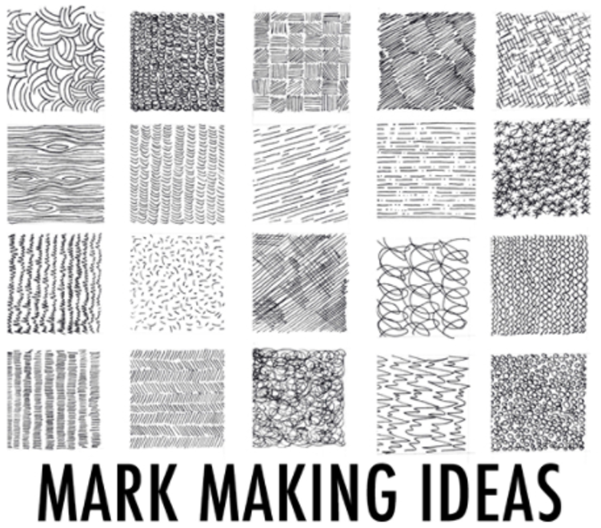

Slide 6
Can you see how Charlie Mackesy uses mark making to create his pictures with an ink pen?

Slide 7
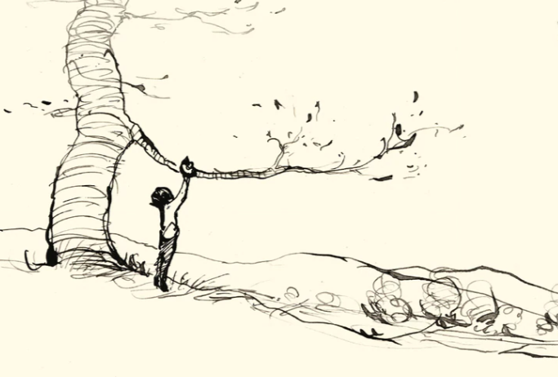

Slide 8
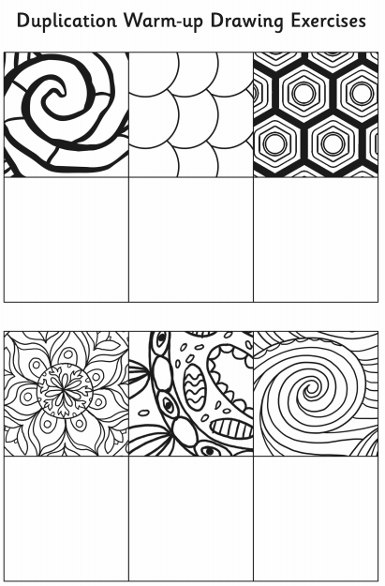
You have two art tasks to complete today. First, complete this duplication warm-up drawing exercise.
Then…

Slide 9
Split a blank piece of A4 paper into 10 boxes then let your pencil run free to create a new technique in each box.
You could mark make
by using lines, dots,
circles or various different
patterns – be creative!
There is a template in
Assignments, if you wish to use it.

