Slide 1
Yatton Junior School
Year 6 Curriculum Evening
Spelling, Punctuation and Grammar (SPAG)
Reading

Slide 2
Spelling
Spelling Rules include:
Challenge words
ie or ei words
Prefixes
Suffixes
Wordings ending ‘ly’
Silent letters

Slide 3
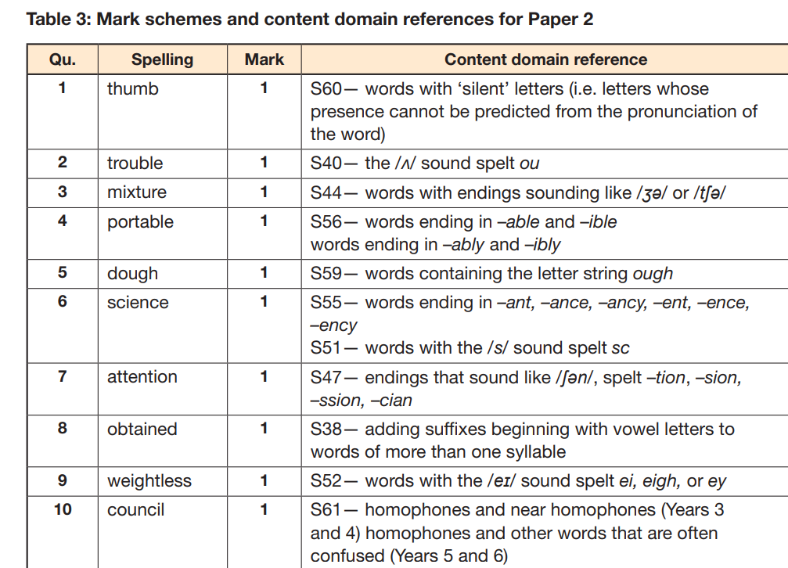
Example Spelling Test

Slide 4
Spelling Shed

Slide 6
Parts-of-speech.Info - POS tagging online

Slide 7
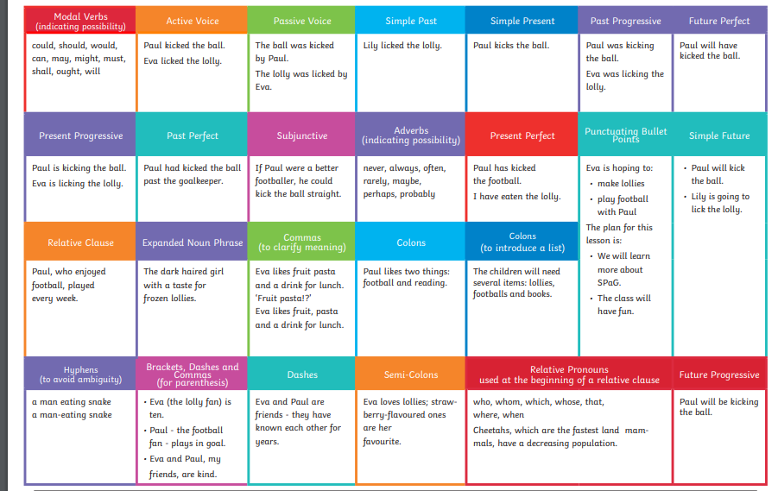

Slide 8
Reading
Homework Booklet includes short story and questions
Each week, homework will be reading and questions will be answered in class.
How can you help?
Shared reading together
Fluency reading – echo reading out loud

Slide 9
How can you help?
Please mark their work each week
Error or misconception? Research together /Hints and Tips section in back of books
Reading questions out loud – in the test adults can read the question out!
Please help with any questions and just make a note that you have helped.
Take out the time issue if it causes stress!
We do the Spelling Test in class.

Slide 10
Example Questions from Revision Guide

Slide 13
Let’s look at some past papers in small groups

