Slide 1
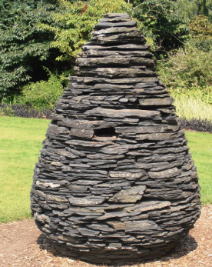
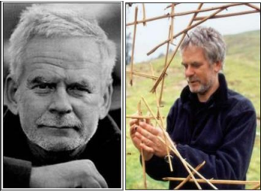
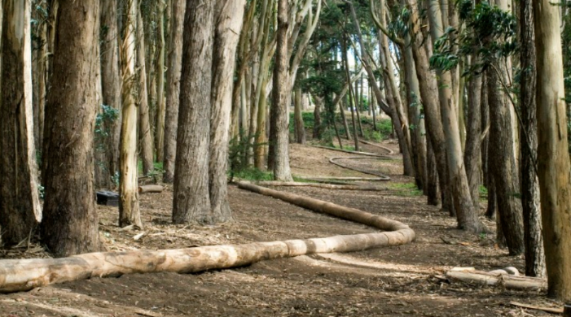
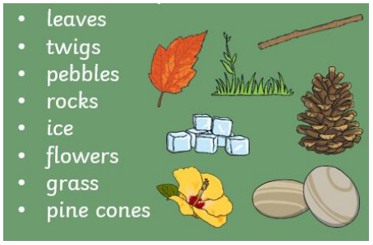
Andy Goldsworthy: KS1 Knowledge Organiser
Subject Specific Vocabulary |  | Sticky Knowledge about Famous people | Key skills
Malleable | A material able to be pressed into shape without breaking or cracking. | Andy Goldsworthy is a British sculptor (a person who makes sculptures) and photographer. He likes to create his sculptures in natural places, using only natural materials. The materials used in his art often include brightly coloured flowers, icicles, leaves, mud, pinecones, snow, stone, twigs and thorns. | To use a range of materials creatively to design and make products To use drawing to develop and share their ideas, experiences and imagination To use painting to develop and share their ideas, experiences and imagination To use sculpture to develop and share their ideas, experiences and imagination To develop a wide range of art and design techniques in using colour, pattern, texture, line, shape, form and space About the work of a range of artists, craft makers and designers, describing the differences and similarities between different practices and disciplines, and making links to their own work
Natural material | Any product that comes from plants, animals or the ground.
Cut | To make an opening, incision with a sharp took or object.
Twist | Form into a bent, curling or distorted shape. | Sticky Knowledge about Famous people
Sculpture | Make or represent (a form) by carving, casting, or other shaping techniques.
Abstract | Art that does not attempt to represent an accurate depiction of a visual reality but uses colour and shapes to achieve its effects.
Shapes | An outline of something.
Statue | A carved or cast figure of a person or animal.

