Slide 1
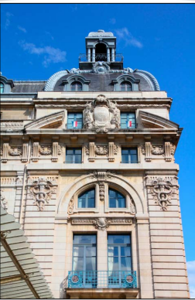
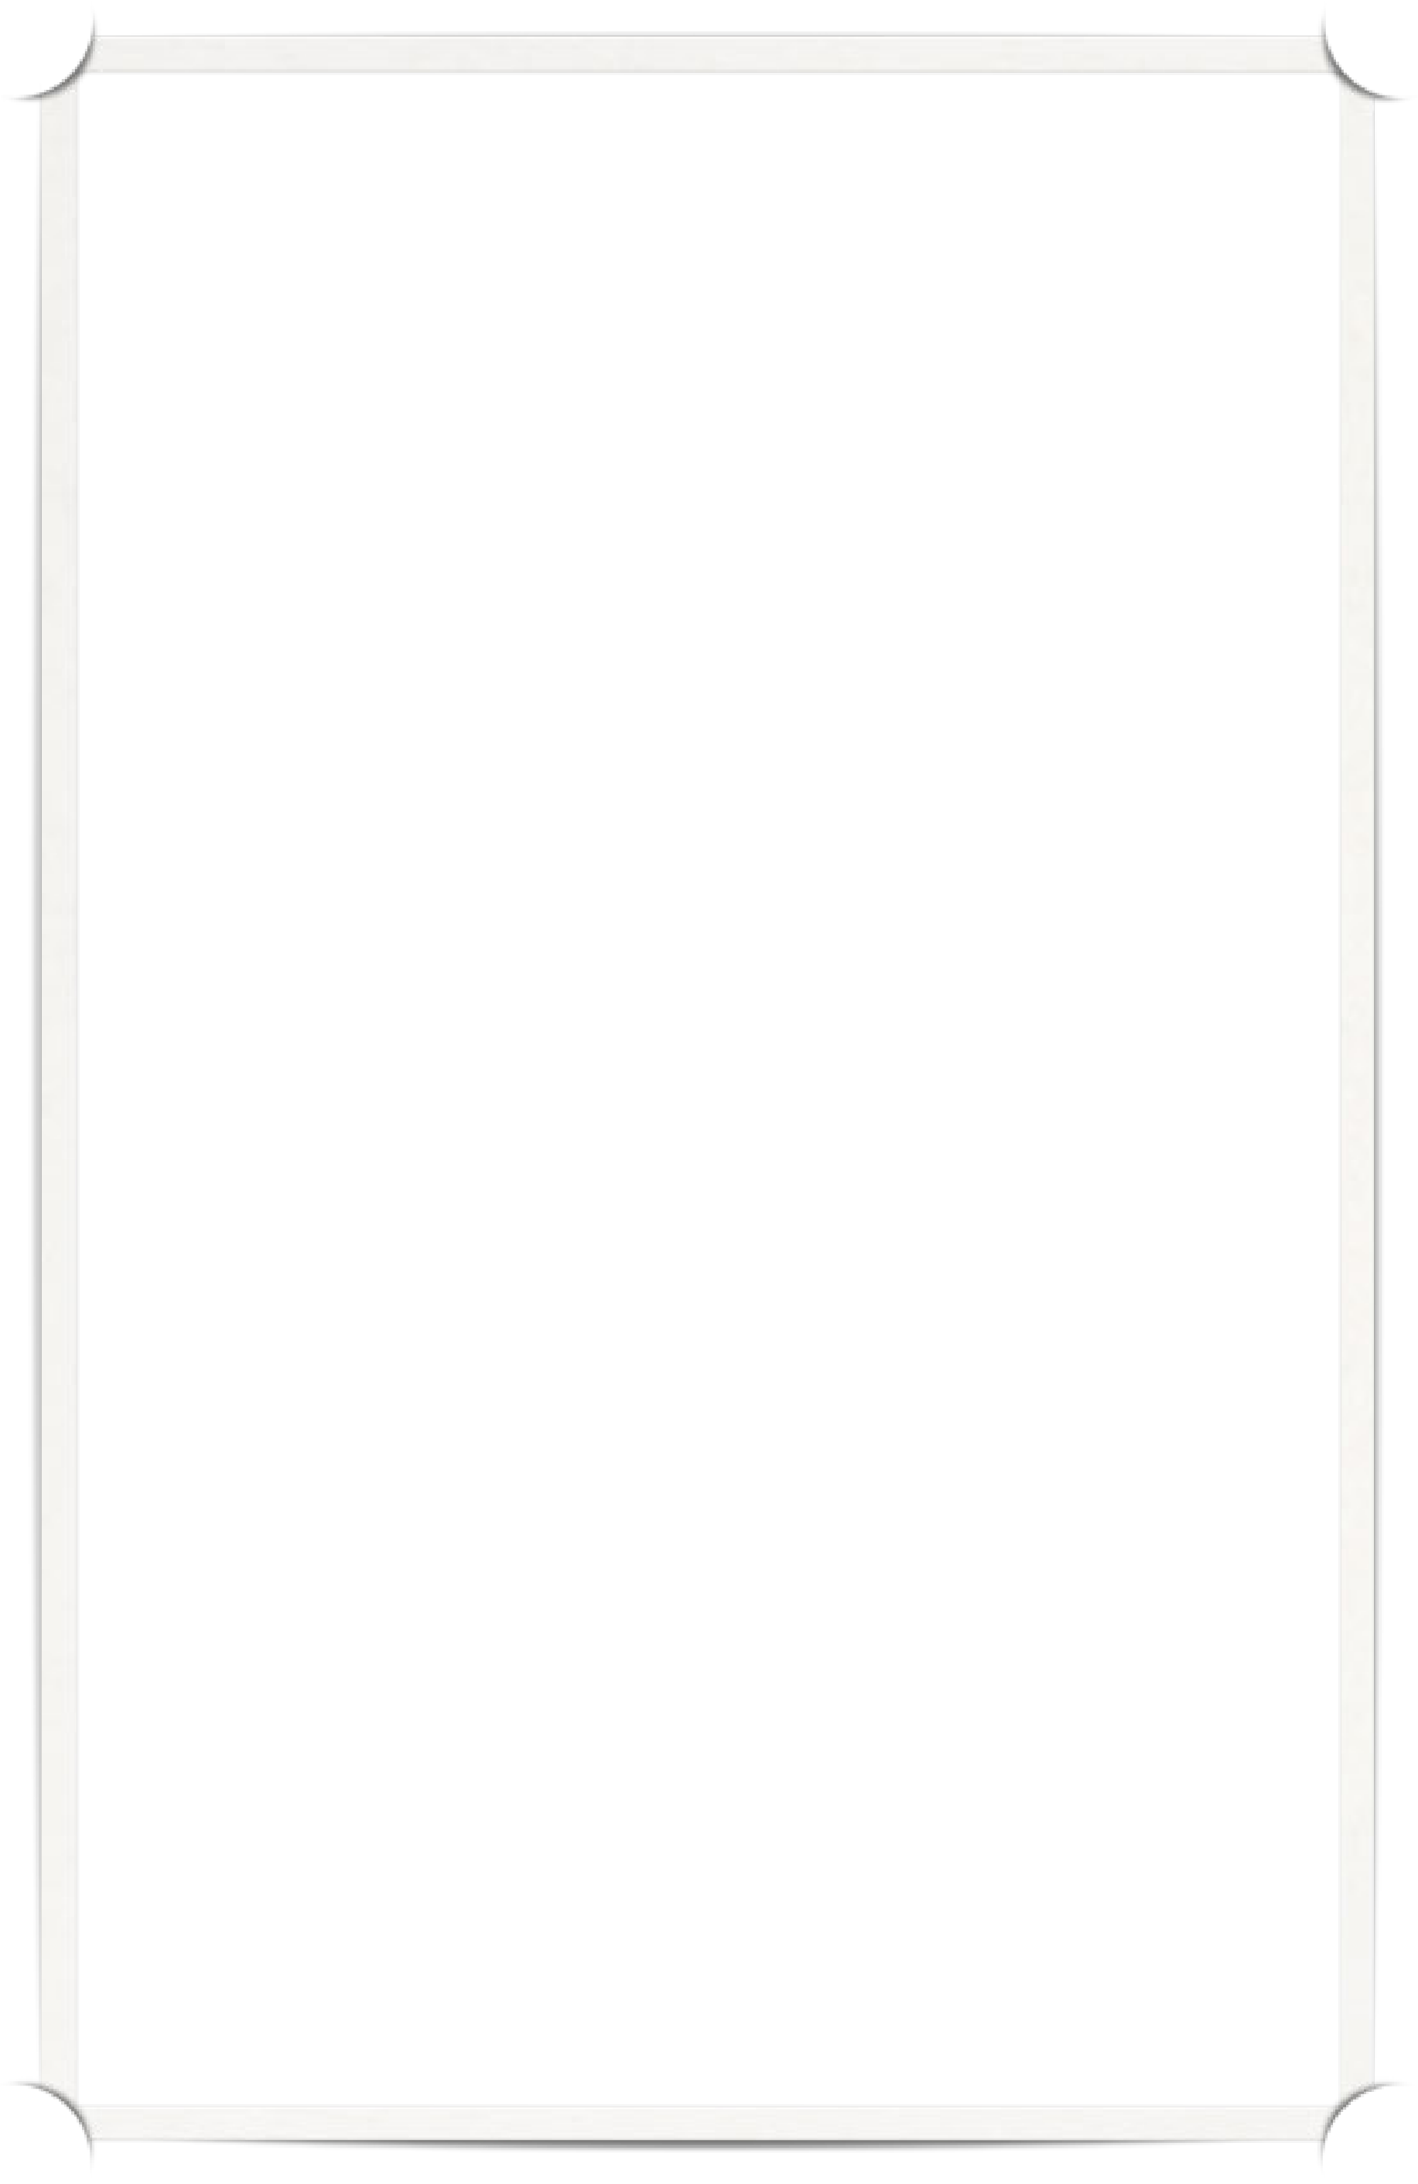
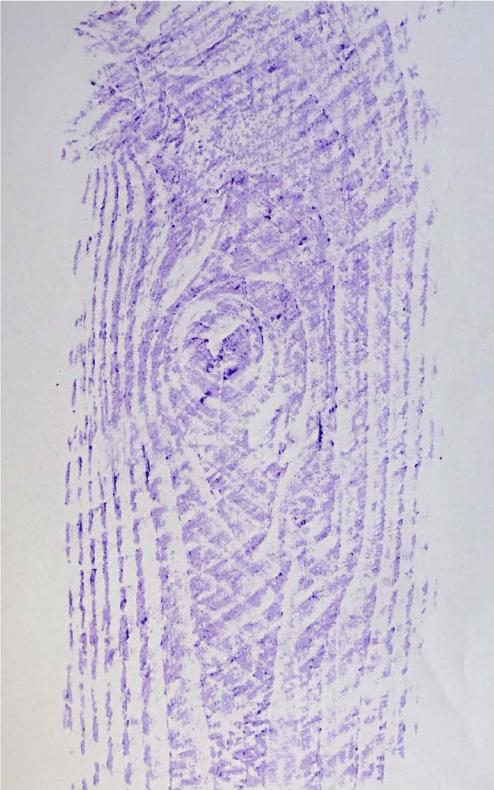
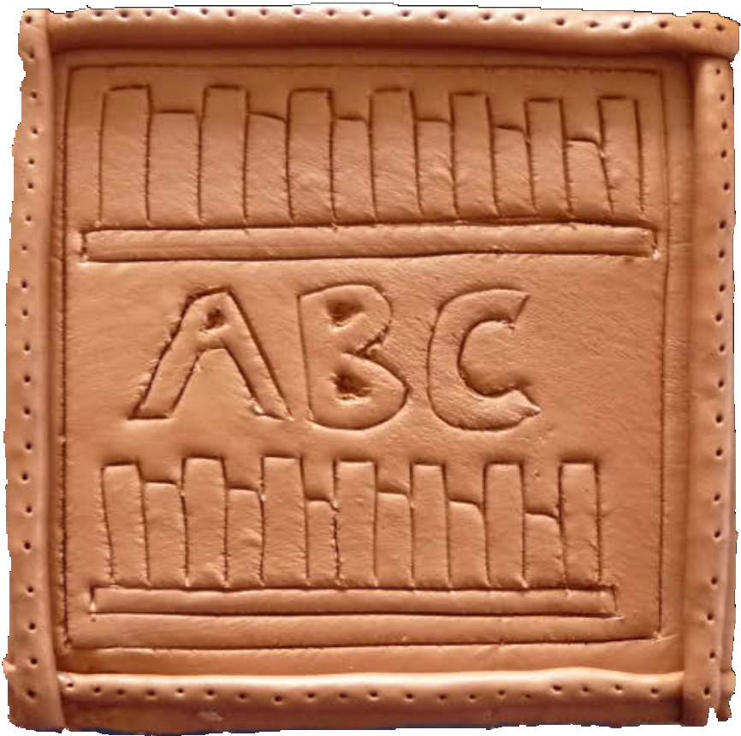

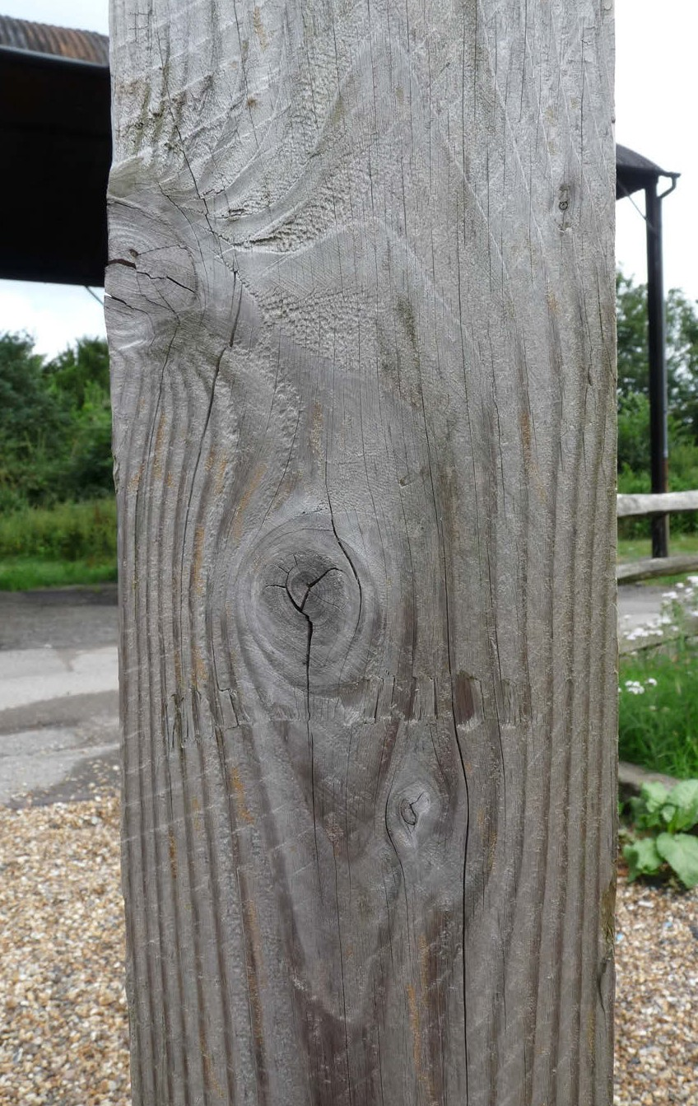
Buildings and Lines: KS1 Knowledge Organiser
Subject Specific Vocabulary | Sticky Knowledge about Famous people | Key skills
Building – a structure with walls and a roof. Shape – a flat figure such as a square, circle, rectangle or triangle. Pattern – a design that repeats. Line – a mark that can be straight, curved, zigzag or wavy. Architect – a person who designs buildings. Feature – an important part of a building. Viewfinder – a frame used to focus on a small section of an image. Texture – how a surface feels or looks. Rubbing – a copy of a textured surface made using paper and wax crayon. Mural – a large piece of artwork. Tile – a small section that can be part of a larger artwork. Clay – a natural material used for modelling and sculpting | Buildings are made from different shapes. Shapes can be found in windows, doors, roofs and walls. Buildings have different purposes such as homes, schools, libraries and places of worship. Buildings from different countries and time periods can look different. Architects design buildings. They think about what buildings are used for. Buildings often contain repeating patterns and lines. We can use a viewfinder to closely study features of a building. We can collect patterns by making wax rubbings from textured surfaces. Artists use patterns, shapes and textures to create artwork inspired by buildings. Clay can be shaped, pressed and carved to create decorative tiles. Individual tiles can be joined together to create a mural. | To use a range of materials creatively to design and make products. To use drawing to develop and share their ideas, experiences and imagination. To use painting to develop and share their ideas, experiences and imagination. To develop a wide range of art and design techniques in using colour, pattern, texture, line, shape, form and space.

