Slide 1
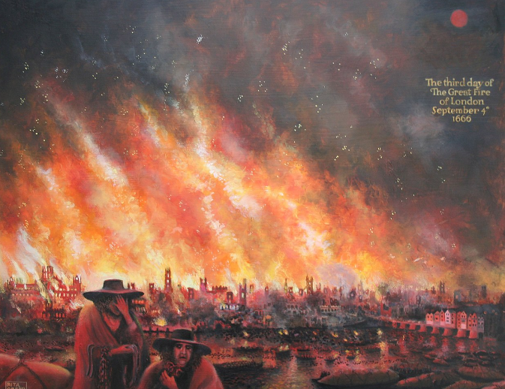
Rita Greer: KS1 Knowledge Mat
Subject Specific Vocabulary |  | Sticky Knowledge about Famous people | Key skills
Foreground | Picture space nearest the viewer. | Historical artists that made the painting of the ‘Great Fire of London’. Born in 1942 and lived in London. Published two books based on Art and cookery. | To use a range of materials creatively to design and make products To use drawing to develop and share their ideas, experiences and imagination To use painting to develop and share their ideas, experiences and imagination To use sculpture to develop and share their ideas, experiences and imagination To develop a wide range of art and design techniques in using colour, pattern, texture, line, shape, form and space
Background | Picture space furthest away.
3D picture | Showing all dimensions of a picture
Scene | The setting of a picture. | Sticky Knowledge about Famous people
Mixed media | Using lots of different art components to build a picture.

