Slide 1

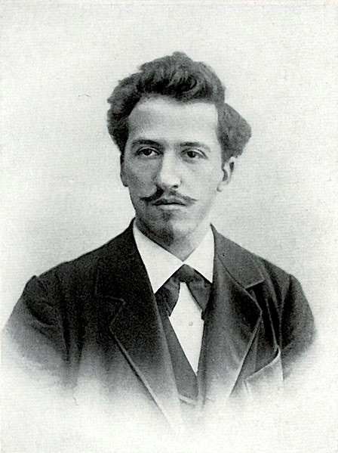

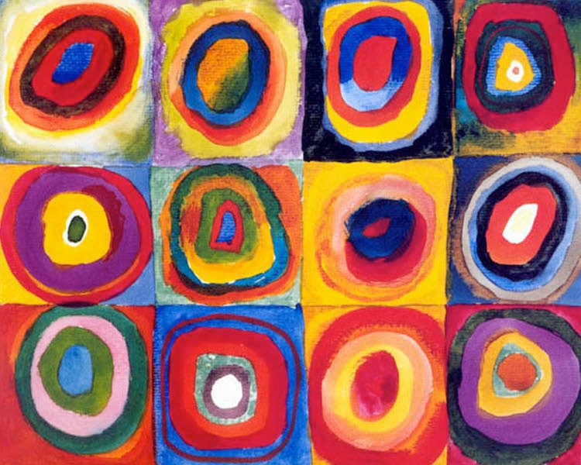


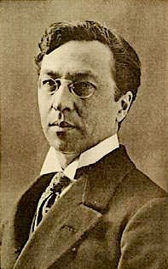
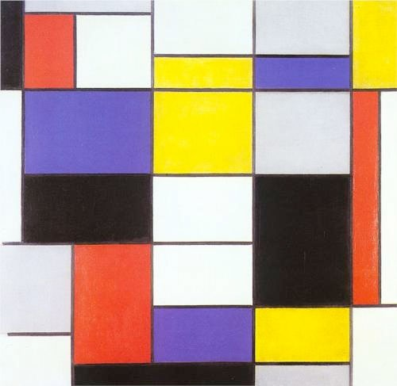
Mondrian & Kandinsky: KS1 Knowledge Organiser
Subject Specific Vocabulary |  | Sticky Knowledge about Famous people | Key skills
Abstract | Art that does not attempt to represent an accurate depiction of a visual reality but uses colour and shapes to achieve its effects. | Mondrian Piet Mondrian was born in the Netherlands in 1872. He was a teacher but enjoyed painting. His first paintings were of landscapes. He is known for his abstract art. He liked painting with primary colours with black lines and white spaces. Mondrian did not use a ruler to draw the straight lines, he used tape or strips of paper. Mondrian was a Dutch artist. Kandinsky Wassily Wassilyevich Kandinsky. He was born in Moscow in 1866. He was a painter and a theorist. He was a lawyer and gave up that career to study art. | To use a range of materials creatively to design and make products To develop a wide range of art and design techniques in using colour, pattern, texture, line, shape, form and space About the work of a range of artists, craft makers and designers, describing the differences and similarities between different practices and disciplines, and making links to their own work.
Shades | When you add black to make a colour darker.
Primary colours | Colours that cannot be made by mixing other colours together. Red, yellow, blue.
Tone | You use a lighter or darker colour to add tone to make it lighter or darker. | Sticky Knowledge about Famous people
Tints | When you add white to a colour to make it lighter.
Expressionism | A style pf painting that seeks to express the inner emotions rather than reality
Theorist | A person who develops ideas of something such as ideas, events and behaviour
Post-impressionism | A style of painting from the 19th and 20th century that explores line, tone and form

