Slide 1
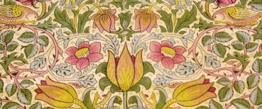
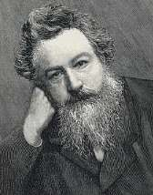
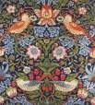
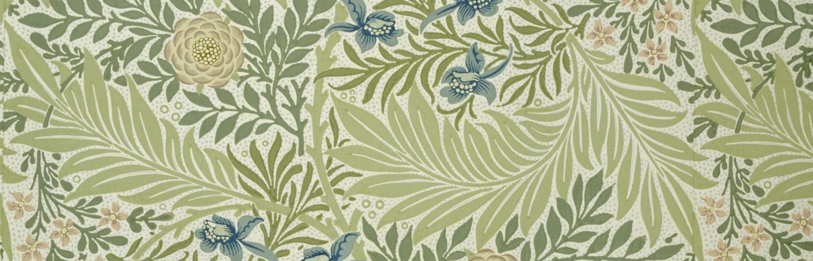
William Morris: KS1 Knowledge Organiser
Subject Specific Vocabulary |  | Sticky Knowledge about Famous people | Key skills
Colour | This is what we can see when light bounces off objects. For example, red, yellow, blue. | William Morris was a British artist born in London in 1834 and died in 1896. He is famous for his patterns and designs inspired by flowers and plants. His designs were printed and repeated many times and used to make wallpapers and fabrics. He used his artwork and designs to create stained glass windows, tapestries, fabrics and wall papers. Identify natural and manmade patterns. Use lines, patterns and tone to extend and develop a piece based upon the work of William Morris. | To use a range of materials creatively to design and make products To use drawing to develop and share their ideas, experiences and imagination To use printing to develop and share their ideas, experiences and imagination To develop a wide range of art and design techniques in using colour, pattern, texture, line, shape, form and space About the work of a range of artists, craft makers and designers, describing the differences and similarities between different practices and disciplines, and making links to their own work
Line | A short or continuous mark made by moving a mark making tool. | He is famous for his patterns and designs inspired by flowers and plants.
Pattern | A repeated decorative design. | His designs were printed and repeated many times and used to make wallpapers and fabrics.
Print making | A print is an impression made by any method involving transfer from one surface to another. | Sticky Knowledge about Famous people
Shade | The act of adding tone to a drawing. | He used his artwork and designs to create stained glass windows, tapestries, fabrics and wall papers. Identify natural and manmade patterns. Use lines, patterns and tone to extend and develop a piece based upon the work of William Morris. Create repeating patterns in the style of William Morris using block printing. Explore printing using a variety of materials, paint and ink.
Shape | An area enclosed by a line.
Texture | This is the way something feels or looks like it feels. | He used his artwork and designs to create stained glass windows, tapestries, fabrics and wall papers. Identify natural and manmade patterns. Use lines, patterns and tone to extend and develop a piece based upon the work of William Morris. Create repeating patterns in the style of William Morris using block printing. Explore printing using a variety of materials, paint and ink.
Tone | This refers to how light or dark something is.

