Slide 1
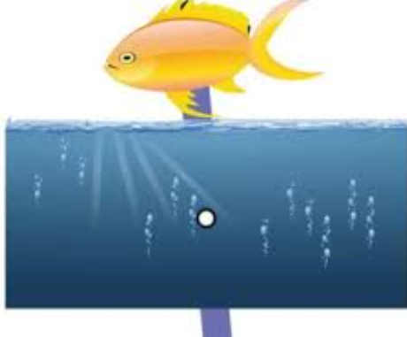
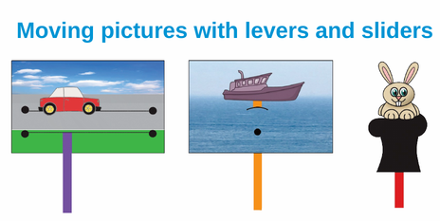
Moving pictures: KS1 Knowledge Organiser
Subject Specific Vocabulary |  | Sticky Knowledge | Key skills
Mechanisms | A systems of parts working together. | Sliders help move things from side to side and up and down. Levers use a fixed point to make things move in a arc (curve),. To recognise different types of movement within simple moving objects. | Generate, develop, model and communicate their ideas through talking, drawing, templates, mock-ups and, where appropriate, information and communication technology. Select from and use a range of tools and equipment to perform practical tasks [for example, cutting, shaping, joining and finishing] Select from and use a wide range of materials and components, including construction materials, textiles and ingredients, according to their characteristics Evaluate their ideas and products against design criteria Explore and use mechanisms [for example, levers, sliders, wheels and axles], in their products
Levers | Where the arm pivots (a turning point).
Joining | To link or connect two things.
Evaluate | To say what is good about their moving picture and what could be improved next time.
Pivot | The point at which something turns.
Fasteners | A range of objects used to fasten together 2 or more pieces of material.

