Slide 1
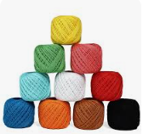
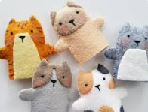
Textiles sewing, puppets: KS1 Knowledge organsier
Subject Specific Vocabulary |  | Sticky Knowledge | Key skills
Textiles | Felt | I understand how simple 3-D textile products are made. Using a template to create two identical shapes . I understand how to join fabrics using different techniques eg running stitch, glue, over-stitch, stapling. I know that puppets come in different shapes and sizes and are made in different ways. I know what a template is. Different materials have different properties (characteristics) which make them good for different purposes. For example, cotton is soft, polyester is durable, and PUL is waterproof. Textiles are used to make clothing, sheets, towels, linen, carpets, rugs and a wide variety of other products. | Design - I know how to design appealing products for a particular user based on simple design criteria - I know how to generate initial ideas and design criteria through own experiences - I know how to develop and communicate these ideas through talk and drawings and mock ups where relevant. Make - I know how to select and use simple utensils, tools and equipment to perform a job eg cut, slides, chop safely, mark out, cut, join and finish - I know how to select a range of ingredients and materials according to their characteristics to create a chosen product. Evaluate - I know how to explore and evaluate a range of products to determine the intended user’s preferences for the product - I know how to evaluate their ideas throughout and finished products against design criteria, including intended user and purpose - I know how explore different finishing techniques - I know how to create a basic over stitch - I can join components by gluing.
Binka | Glue
Cotton | Over stitch
Needle | Evaluate
Template | Sew
Design | Thread

