Slide 1


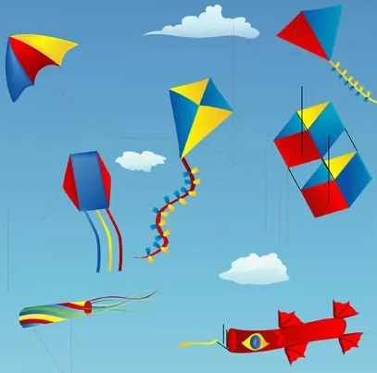


Kites: KS1 Knowledge Organiser
Subject Specific Vocabulary |  | Sticky Knowledge | Key skills
Aerodynamics | How the air moves around an object that is travelling through it. | Originated in China at least 2000 years ago. Used in competitions all around the world. Kite flying is a traditional activity in Japan at New Year. A kite was flown by Homan Walsh from one side of the Niagara Gorge to the other, which led the way for the Niagara Falls Bridge to be built. Kite flying is a balance between aerodynamic forces and the weight of the different parts of the kite. Someone runs with the kite against the wind. The wind creates a force (lift) that pushes up on the kite. As the same time, another force, (drag) which is caused by the wind catching on the kite, pulls the kite back in the opposite direction. Most kites are made from some of the following materials: lightweight paper, nylon, bamboo/wood and plastic. The main parts of a kite include sail, spars, tail, bridle lines, vents and keel. | Design purposeful, functional, appealing products for themselves and other users based on design criteria Generate, develop, model and communicate their ideas through talking, drawing, templates, mock-ups and, where appropriate, information and communication technology. Evaluate their ideas and products against design criteria
Force | A push or pull on an object.
Diamond | A kite shape / name that is known to be stable and reliable.
Rokkahu | A kite shape / name that is hexagonal and easy to fly.
Delta | A kite shape / name that is triangular and good in light winds.
Sled | A kite shape / name that has a tail hanging from each spar.

