Slide 1
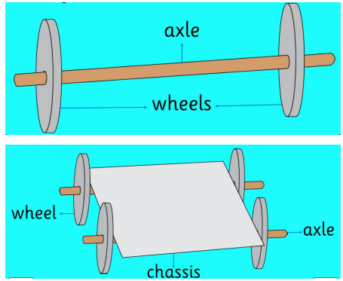
Moving vehicles: KS1 Knowledge Organiser
Subject Specific Vocabulary |  | Sticky Knowledge | Key skills
Vehicle | A thing used for transporting people or goods. | That vehicles can move forwards and backwards. Wheels move around in order for a vehicle to work. Know that on a vehicle The wheels need to be fixed to an axle. The axle needs to move freely in the chassis. Know that some materials are stronger and more rigid (stiffer) than others e.g. thick card is stronger and more rigid than paper. | Design purposeful, functional, appealing products for themselves and other users based on design criteria Generate, develop, model and communicate their ideas through talking, drawing, templates, mock-ups and, where appropriate, information and communication technology. Select from and use a range of tools and equipment to perform practical tasks [for example, cutting, shaping, joining and finishing] Select from and use a wide range of materials and components, including construction materials, textiles and ingredients, according to their characteristics Explore and evaluate a range of existing products Evaluate their ideas and products against design criteria Explore and use mechanisms [for example, levers, sliders, wheels and axles], in their products
Wheel | A circular object that revolves on an axle and is fixed below a vehicle.
Axle holder | The part through which an axle fits and rotates,
Axle | A rod passing through the centre of a wheel or group of wheels.
Chassis | The base frame of a car, carriage, or other wheeled vehicle.
Body | The amin section of a motor vehicle or aircraft.
Moving
 | In motion.

