Slide 1
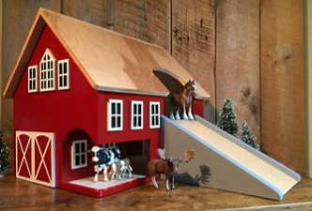
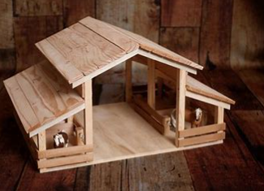
Stable Structures: KS1 Knowledge Organiser
Subject Specific Vocabulary |  | Sticky Knowledge | Key skills
Stable – strong and balanced so it does not fall over. | Strong – able to hold weight without breaking. | A stable structure is strong and does not easily fall over. Structures are built for a purpose (e.g. animal homes likes barns). Different materials have different properties (wood is strong, cardboard is light). A design plan helps you build a product step by step. Good structures need to be strong, stiff and secure. You can improve designs by testing and evaluating them. Choosing the right material makes a structure more successful. | Design purposeful, functional, appealing products for themselves and other users based on design criteria. Generate, develop, model and communicate their ideas through talking, drawing, templates, mock-ups and, where appropriate, information and communication technology. Select from and use a range of tools and equipment to perform practical tasks [for example, cutting, shaping, joining and finishing]. Select from and use a wide range of materials and components, including construction materials, textiles and ingredients, according to their characteristics. Explore and evaluate a range of existing products. Build structures, exploring how they can be made stronger, stiffer and more stable.
Structure – something that is built, like a building or model. | Stiff – does not bed or change shape easily.
Material – what something is made from | Properties – the qualities or a material (e.g. strong, waterproof, smooth).
Design – a drawing or idea that shows how something will look or work | Purpose – the job something is meant to do.
Plan – a detailed drawing or set of steps to help you build something | Feature – an important part or characteristic of something.
Evaluate – to look at something and decide how good it is and how it could be better.

