Slide 1
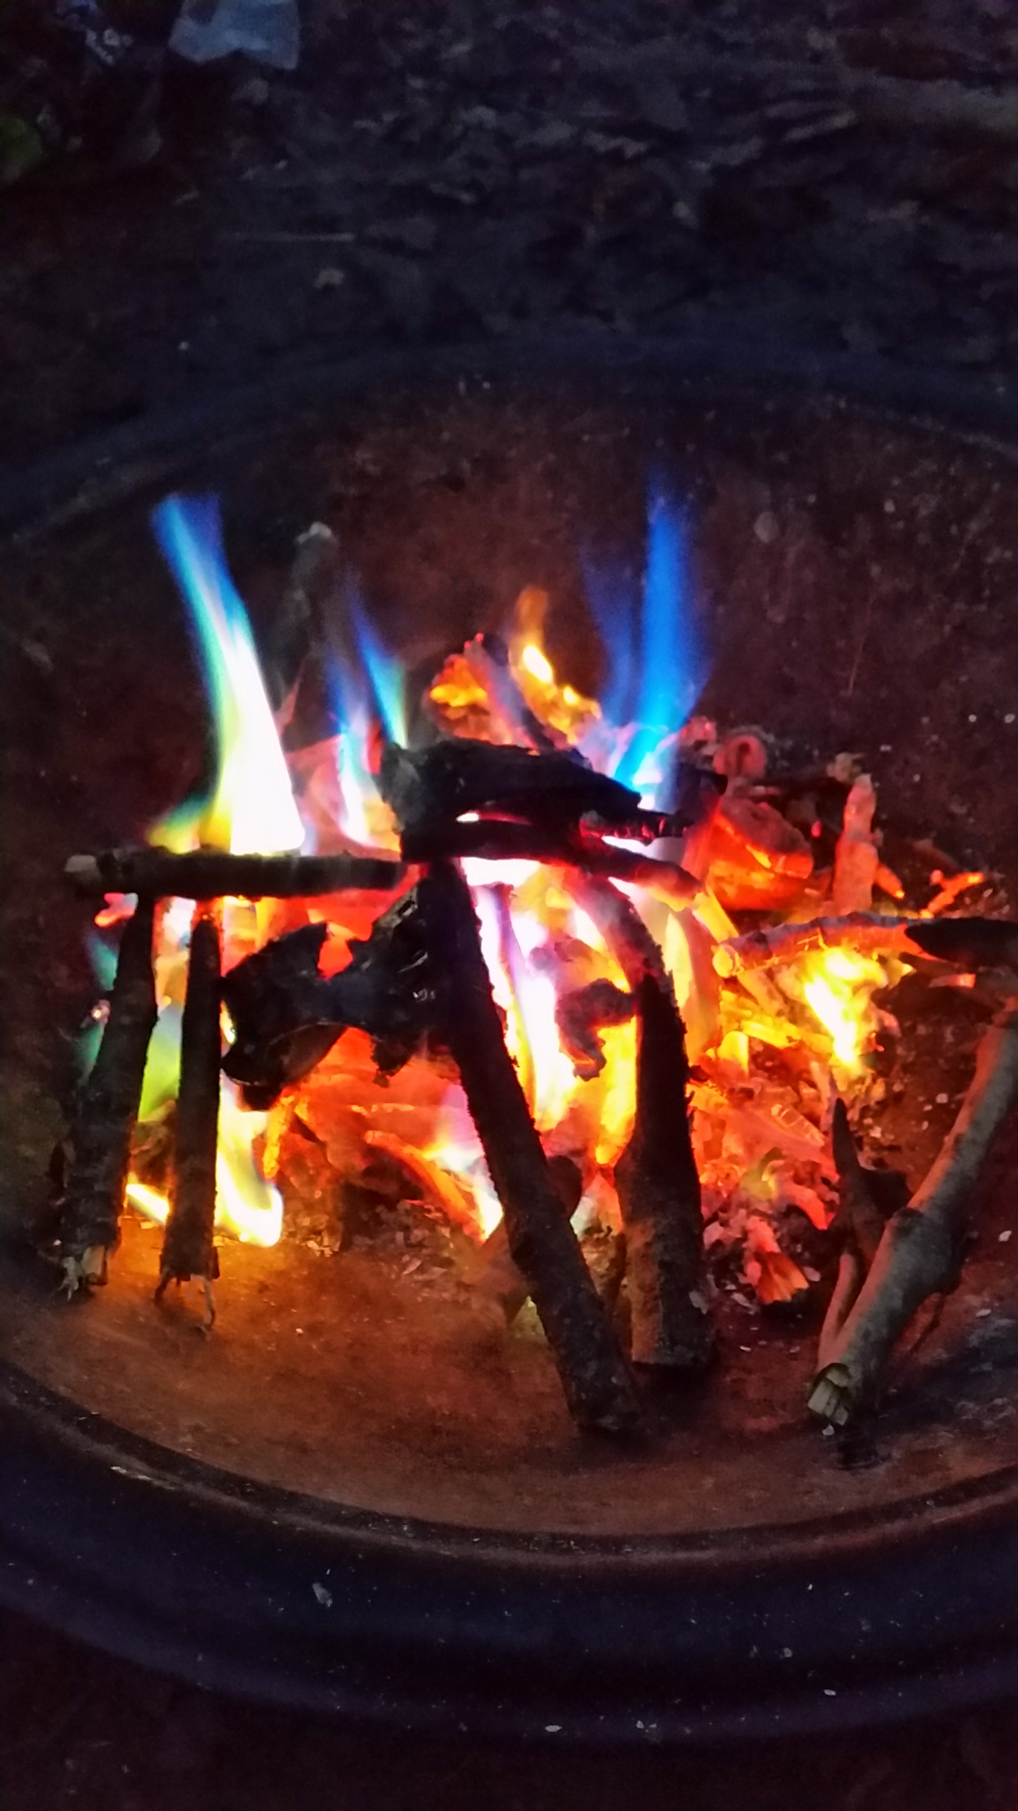
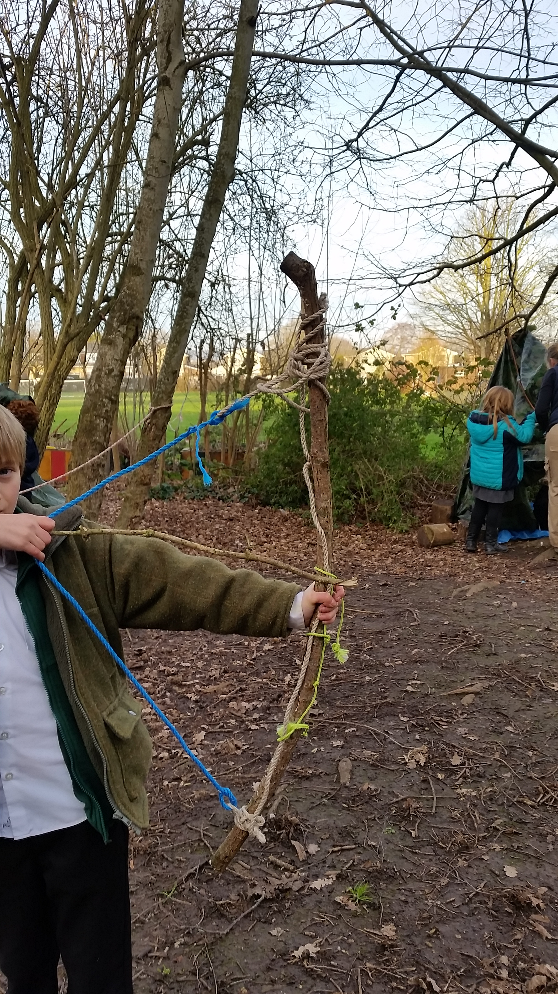
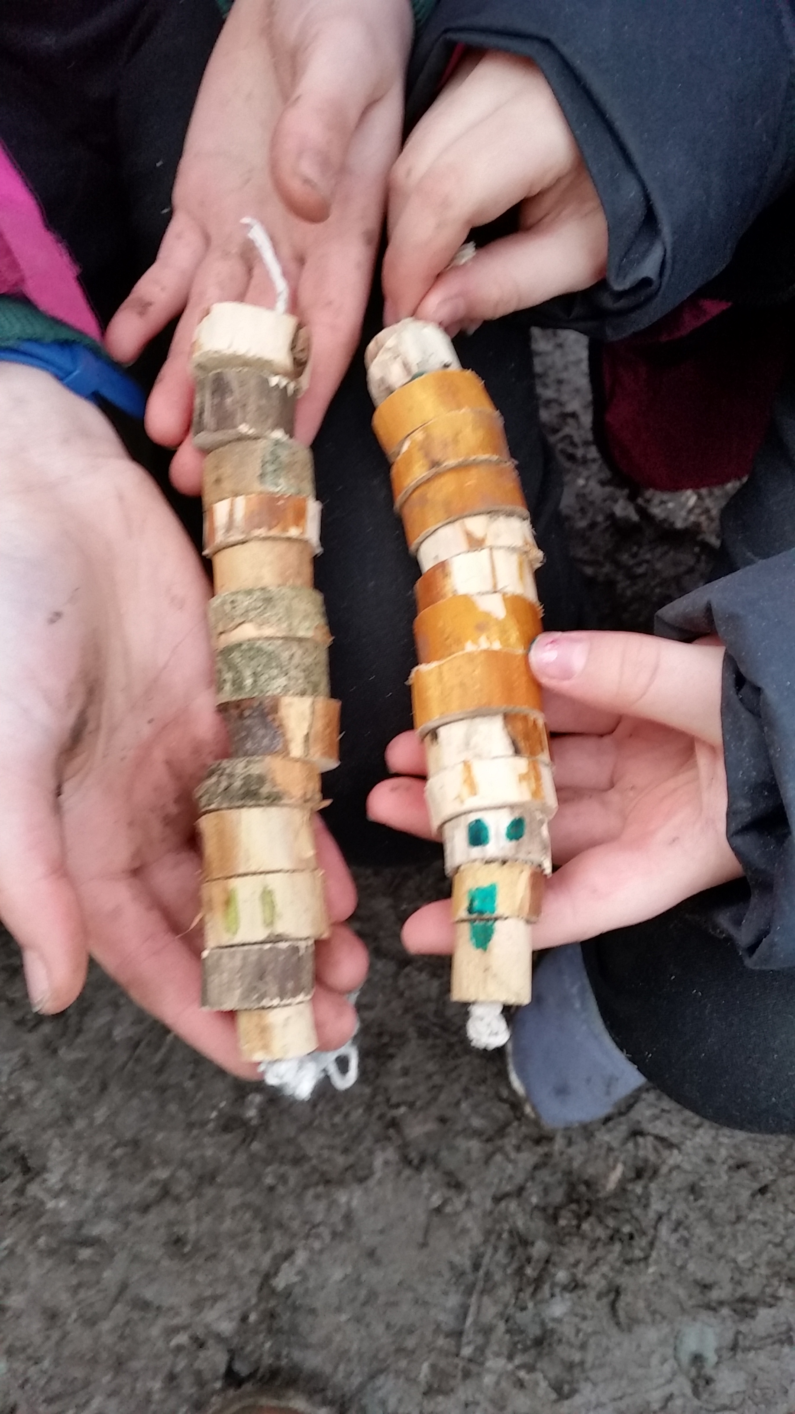
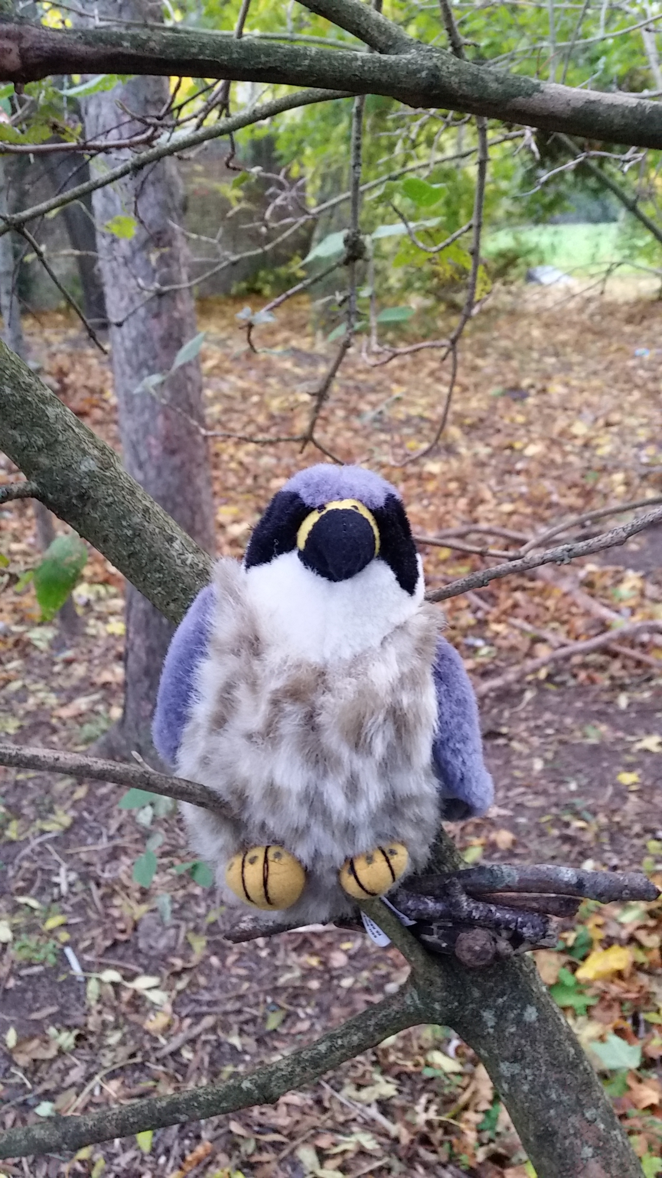

Forest School Club
Activities include cooking, woodland craft, treasure hunts, den-building, obstacle course, games and nature conservation. £49/7 weeks.
Bookings: www.bookwhen.com/yeovaleforestschool or contact chloe@yeovaleforestschool.co.uk
Tuesdays Yr 1 and Yr 2 3.20pm – 4.30pm
Wednesdays Reception 3.20pm – 4.20pm
Thursdays Yr 2 – 6 3.20pm – 4.30pm

